Slide 1
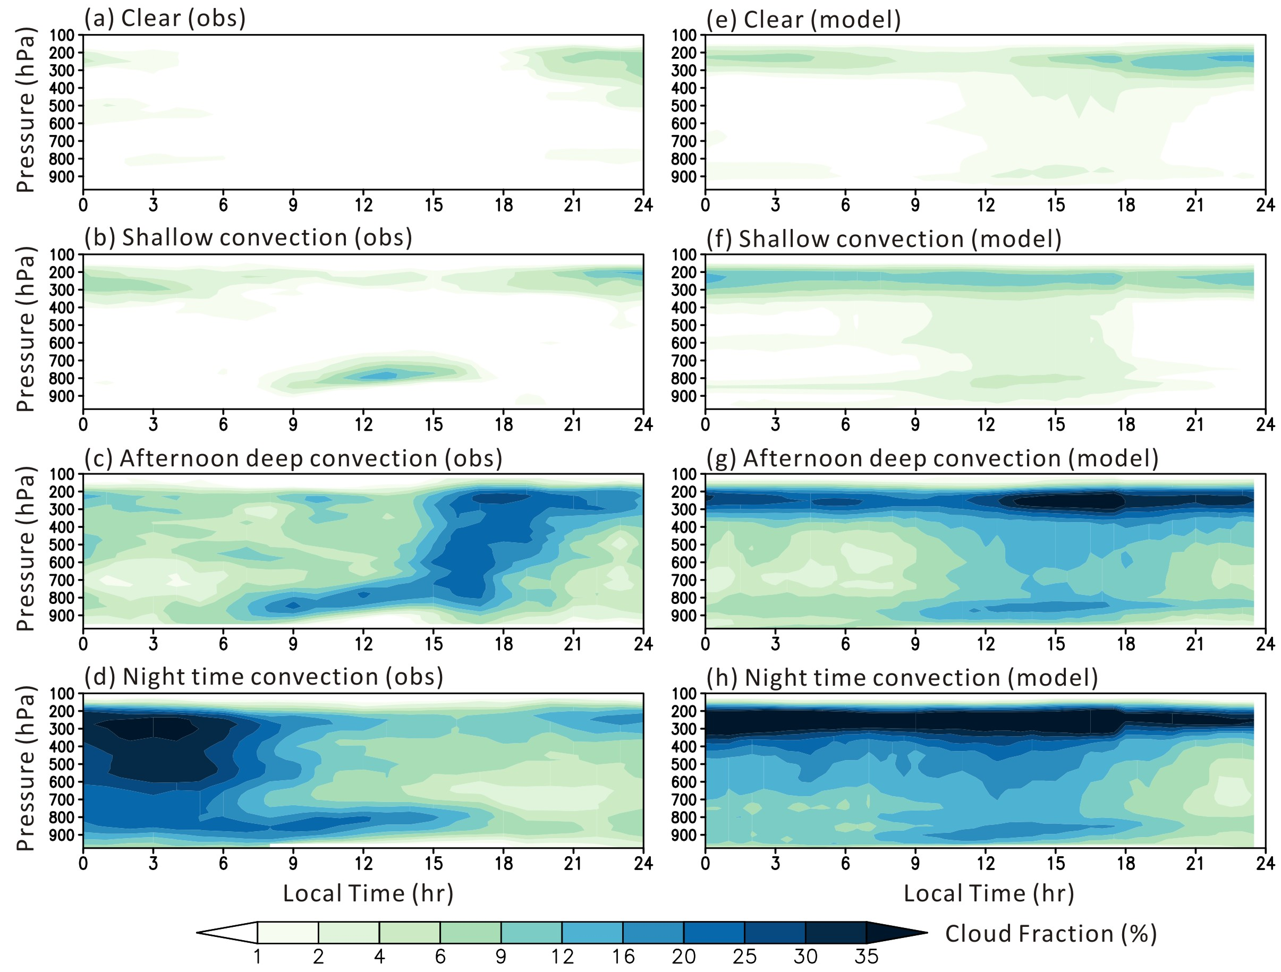
A better way to gain insights into climate model moist process errors
RGMA
Science Questions
Can we better evaluate climate model moist processes from diurnal to interannual time scales?
Key Accomplishments
We present a multi-year short-range hindcast experiment and its experimental design. We can compare hindcasts with corresponding long-term observations for periods based on different phenomena to gain insights into model errors and their connection to physical parameterizations.
Comparison of hindcasts to the typical simulations in climate mode with the same model allows one to infer what portion of a model’s climate error directly comes from fast errors in the parameterizations of moist processes.
Diurnal cycle of cloud fraction composites
(May-August 1997-2007)
One can identify specific cloud regime deficiencies in the model under very similar large-scale meteorological conditions and attribute possible causes to specific model parameterizations.
Ma, H.-Y., and coauthors (2021), A multi-year short-range hindcast experiment with CESM1 for evaluating climate model moist processes from diurnal to interannual timescales. Geosci. Model Dev., 14, 73–90. https://doi.org/10.5194/gmd-14-73-2021.

