Slide 1
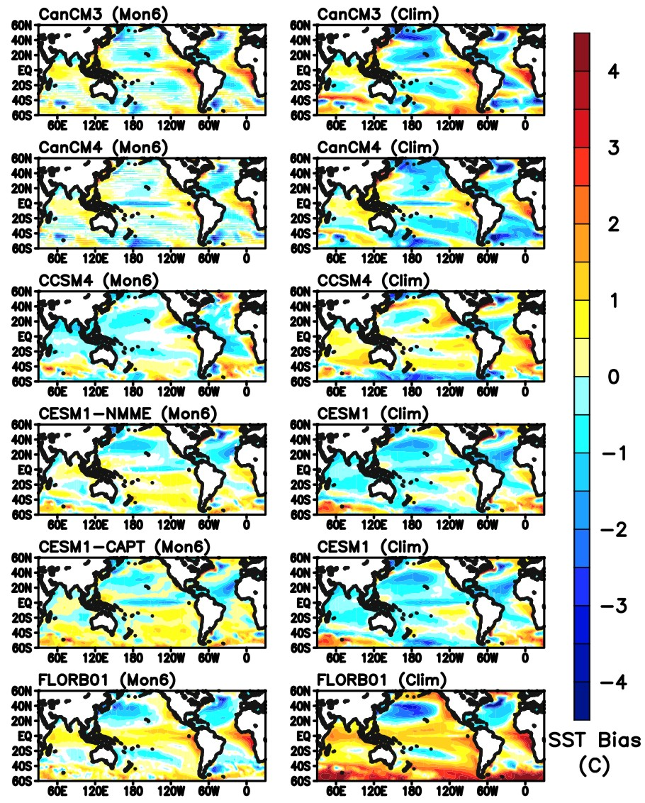
On the correspondence between seasonal forecast biases and long-term climate biases in sea surface temperature
RGMA
Science Questions
Is there a good correspondence between short- and long-term sea surface temperature (SST) biases over regions of large biases, and whether the correspondence is consistent across all the models?
Key Accomplishments
Most robust climatological SST biases begin to form within 6 months of a realistically initialized integration, although the growth rate varies with location, time, and model.
In regions with large biases, interannual variability and ensemble spread is much smaller than the climatological bias.
Fast processes with times scales shorter than the seasonal time scales in the atmosphere and upper ocean are responsible for a substantial part of the climatological SST biases.
Ma, H.-Y., and coauthors (2020), On the correspondence between seasonal forecast biases and long-term climate biases in sea surface temperature. J. Climate, https://doi.org/10.1175/JCLI-D-20-0338.1
Most robust climatological SST biases (left panels) begin to form within 6 months of hindcasts (right panels)

