Slide 1
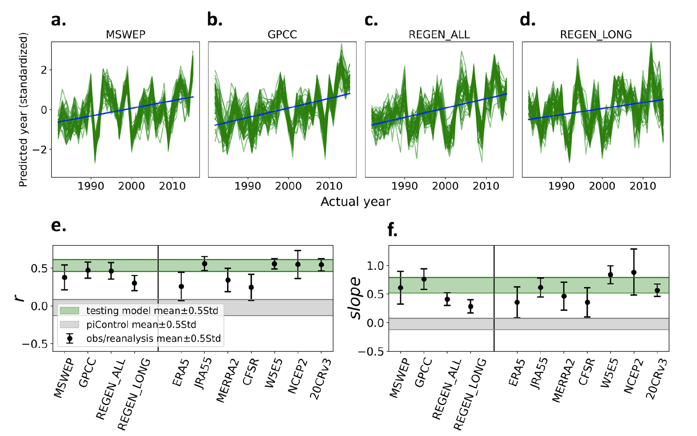
Anthropogenic influence on extreme precipitation over global land areas seen in multiple observational datasets
Scientific Achievement By identifying the time evolution of the spatial patterns of extreme precipitation using explainable artificial intelligence, UCLA scientists detected the human influence in extreme precipitation over global land in multiple disparate observational records. Significance & Impact
Although it is well established that anthropogenic climate change is inﬂuencing extreme precipitation, detecting this signal in historical records has until now been challenging. And the uncertainty that arises from observational datasets constructed using different techniques has not previously been addressed. This is mainly because traditional techniques that are used to extract the signal from noise in observations require long-spanning high-quality datasets. By employing machine learning, this study is the first to generate multiple lines of evidence of the human inﬂuence on extreme precipitation.
Projection of the observations onto the fingerprints of the anthropogenic influence identified by the artificial neural network (top panels) allows us to assess whether we can detect the signal that we see in climate models. Signal is assessed as the correlation (r) and the slope of these projections (bottom panels).
Research Details In this study, scientists trained an artificial neural network (ANN) to identify the changes in spatial patterns of global maps of annual maximum daily precipitation using CMIP5 and CMIP6 global climate model simulations. Using ANN visualization techniques, they assessed the physical interpretability of the ANN and obtained a physically interpretable fingerprint. Finally, they applied the trained model to historical records and found that the human influence can be seen in all the datasets they analyzed for the period 1982-2015.
Madakumbura, G. D., Thackeray, C. W., Norris, J., Goldenson, N., & Hall, A. (2021). Anthropogenic influence on extreme precipitation over global land areas seen in multiple observational datasets. Nature Communications, 12(1), 3944. https://doi.org/10.1038/s41467-021-24262-x

