Slide 1
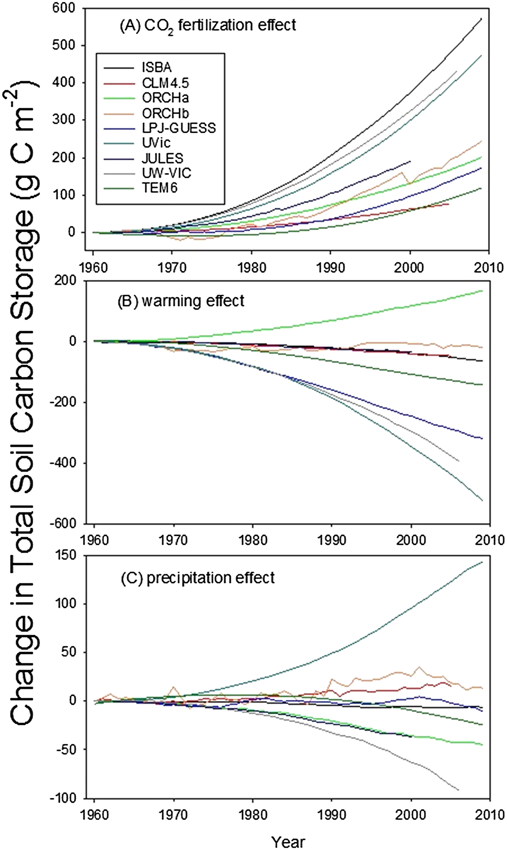
Permafrost Carbon Network model intercomparison project
Permafrost domain: 1960-2009
Objective: We evaluated the variability in sensitivity of permafrost and C among land surface model simulations over the permafrost region between 1960 and 2009.
Results: The 15 model simulations all predict near-surface permafrost loss but there are large differences in simulated rates (0.2 to 58.8 × 103 km² yr⁻¹). All models indicate that both vegetation and soil C storage together have increased by 156 to 954 Tg C yr⁻¹ even though model analyses indicate that warming alone would decrease soil C storage. Increases in GPP largely explain simulated increases in vegetation and soil C. To improve modeling of C in permafrost, there is need for community to standardize structural representation of permafrost and carbon.
McGuire, A.D., C. Koven, D.M. Lawrence, et al., 2016: A model-based analysis of the vulnerability of carbon in the permafrost region between 1960 and 2009. Glob. Biogeoch. Cyclesi, DOI: 10.1002/2016GB005405.

