Slide 1
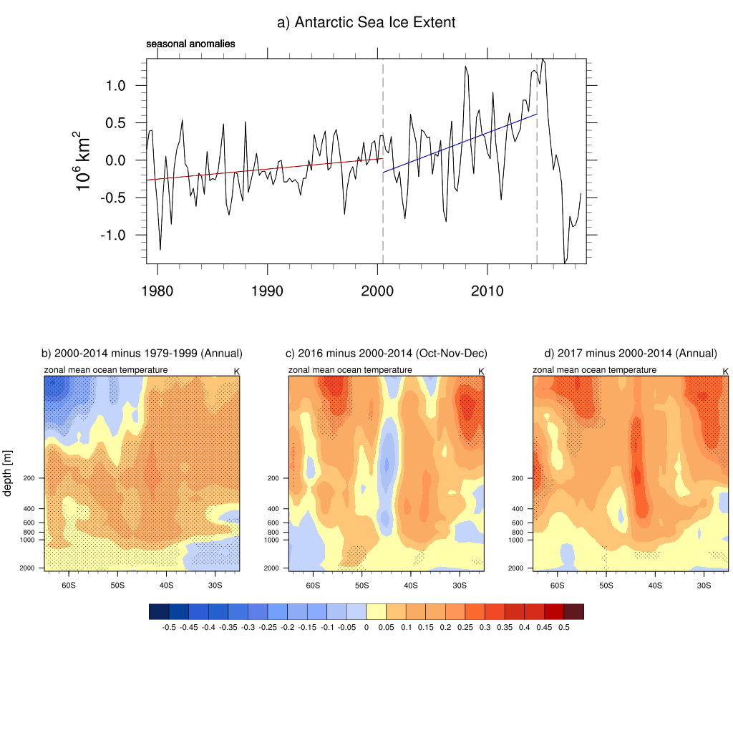
Sudden, dramatic and sustained Antarctic sea ice retreat starting in 2016
Objective: Understand how and why Antarctic sea ice, which had been expanding, suddenly retreated to lowest values in the instrumental record in late 2016
Expansion of Antarctic sea ice accelerated after 2000
Sudden retreat of Antarctic sea ice starting in late 2016 sustained
through 2017
Research:
--Analyze atmospheric and ocean Argo float observations
--analyze a global atmospheric model run with a specified convective heating anomaly representing the record high SST and precipitation anomalies in the eastern Indian/western Pacific Oceans in late 2016 to study associated atmospheric teleconnections that could have contributed to the decreases in sea ice
2016
Cold upper southern ocean during sea ice expansion
Warm upper southern ocean in 2016 sustained through 2017 with sea ice retreat
Impact: What caused the retreat of Antarctic sea ice?
--Anomalous mid- and high latitude southward surface winds forced from the tropics
--A warmer upper Southern Ocean that was the culmination of a negative decadal trend of wind stress curl with positive Southern Annular Mode and negative Interdecadal Pacific Oscillation, Ekman suction that moved warmer water upward in the column closer to the surface, a transition to positive Interdecadal Pacific Oscillation around 2014-2016, and negative Southern Annular Mode in late 2016.
Top panel: Observed seasonal anomalies of sea ice extent from 1979 through JJA 2018 (10⁶ km²; vertical dashed lines denote DJF 2000 at the start of the negative IPO period, and DJF 2014 marking the end of the negative IPO period; trend lines are calculated through the seasonal anomalies b) zonal mean temperatures (˚C) from EN4 reanalysis data, base state differences for negative IPO period (2000-2014) minus positive IPO period (1979-1999), stippling denotes significance at the 5% level; c) as in (b) except for October-November-December (OND) 2016 minus 2000-2014 OND mean; d) as in (b) except for 2017 annual mean minus 2000-2014 mean.
Meehl, G.A., J.M. Arblaster, C.T.Y. Chung, M. M. Holland, A. DuVivier, L. Thompson, D. Yang, and C.M. Bitz, 2019: Recent sudden Antarctic sea ice retreat caused by connections to the tropics and sustained ocean changes around Antarctica, Nature Comms., 10:14, https://doi.org/10.1038/s41467-018-07865-9.

