Slide 1
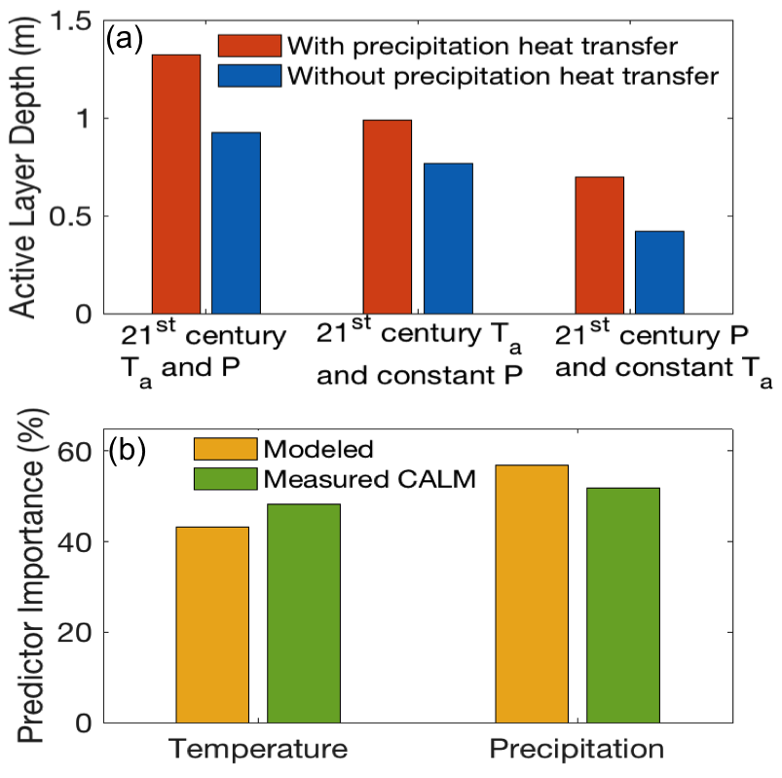
Changes in precipitation and air temperature contribute comparably to permafrost degradation in a warmer climate
Scientific Achievement
Using observations and a mechanistic ecosystem model, we show that increases in precipitation hasten active layer development beyond that caused by surface air warming across the North Slope of Alaska under recent and 21st century climate.
Significance and Impact
Ignoring precipitation heat content in the model resulted in lower spatially-averaged soil temperatures and a 39 cm shallower active layer by 2100.
Projected increases in 21st century precipitation deepen the active layer by enhancing precipitation heat transfer and ground thermal conductivity.
Precipitation is as important a control on permafrost degradation as surface air temperature.
Figure. Precipitation is as important as surface air temperature for both modeled and measured active layer depth across the 28 NSA CALM sites.
Research Details
Mekonnen, Z.A., Riley, W.J., Grant, R.F. and Romanovsky, V.E., (2021). Changes in precipitation and air temperature contribute comparably to permafrost degradation in a warmer climate. Environmental Research Letters, 16(2): 024008.
We applied a mechanistic ecosystem model to examine the relative importance of changes in surface air temperature and precipitation on permafrost degradation in the continuous permafrost zone.

