Slide 1
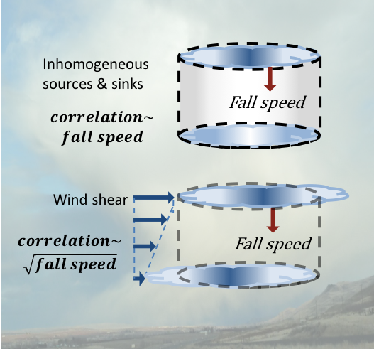
Level by Level: Constructing the Vertical Structure of Clouds
Objective
Improve representation of unresolved cloud and precipitation structure in DOE’s Energy Exascale Earth System Model (E3SM)
Approach
Quantify vertical alignment of cloud properties by correlation between distributions at adjacent levels
Compute correlations for mass and number concentrations, as well as radar reflectivity factors of liquid and frozen hydrometeors, for model-simulated and radar-observed fields
Impact
Vertical correlation found to be a strong function of mean fall speed of cloud and precipitation properties
Wind shear reduced alignment of slow-falling hydrometeor species but had limited effect on faster-precipitating hydrometeor categories
Proposed parameterization provides a consistent treatment of cloud and precipitation overlap for radiation, microphysics, and instrument simulator calculations
In models that do not explicitly resolve the vertical structure of individual clouds, correlation of cloud properties between different levels can be parameterized as a function of fall speed of droplets and ice particles.
Ovchinnikov M, S Giangrande, VE Larson, A Protat, and CR Williams. 2019. “Dependence of Vertical Alignment of Cloud and Precipitation Properties on Their Effective Fall Speeds.” Journal of Geophysical Research: Atmospheres 124(4):2079–2093, https://doi.org/10.1029/2018JD029346.
Notes:
Ovchinnikov M, S Giangrande, VE Larson, A Protat, and CR Williams. 2019. “Dependence of Vertical Alignment of Cloud and Precipitation Properties on Their Effective Fall Speeds.” Journal of Geophysical Research: Atmospheres 124(4):2079–2093, https://doi.org/10.1029/2018JD029346.
Abstract
The vertical structure of clouds unresolved in large-scale weather prediction and climate models is controlled by an overlap assumption. When a binary representation (cloud or no-cloud) of subgrid horizontal variability is replaced by a probability density function (PDF) treatment of cloud-related variables, a cloud occurrence overlap needs to be replaced by a PDF overlap. The PDF overlap can be quantified by a correlation length scale, z₀, indicating how rapidly rank correlation of distributions at two levels diminishes with increasing level separation. In this study, we show that z₀ varies widely for different properties (e.g., number and mass mixing ratios) and different hydrometeor types (cloud liquid and ice, rain, snow, and graupel) and that corresponding fall speed, V_{f}, is the primary factor controlling the degree of their vertical alignment, with vertical shear of the horizontal wind playing a smaller role. Linear and power-law parametric relationships between z₀ and V_{f} are derived using cloud-resolving simulations of convection under mid-latitude continental and tropical oceanic conditions, as well as observations from vertically-pointing dual-frequency radar profilers near Darwin, Australia. The functional form of z₀ – V_{f} relationship is further examined using simple conceptual models that link variability in horizontal and vertical directions and provide insights into the role of V_{f} and wind shear. Being based on a physical property (i.e., fall speed) of hydrometeors rather than artificially defined and model-specific hydrometeor types, the proposed parameterization of vertical PDF overlap can be applied to a wide range of microphysics treatments in regional and global models.

