Slide 1
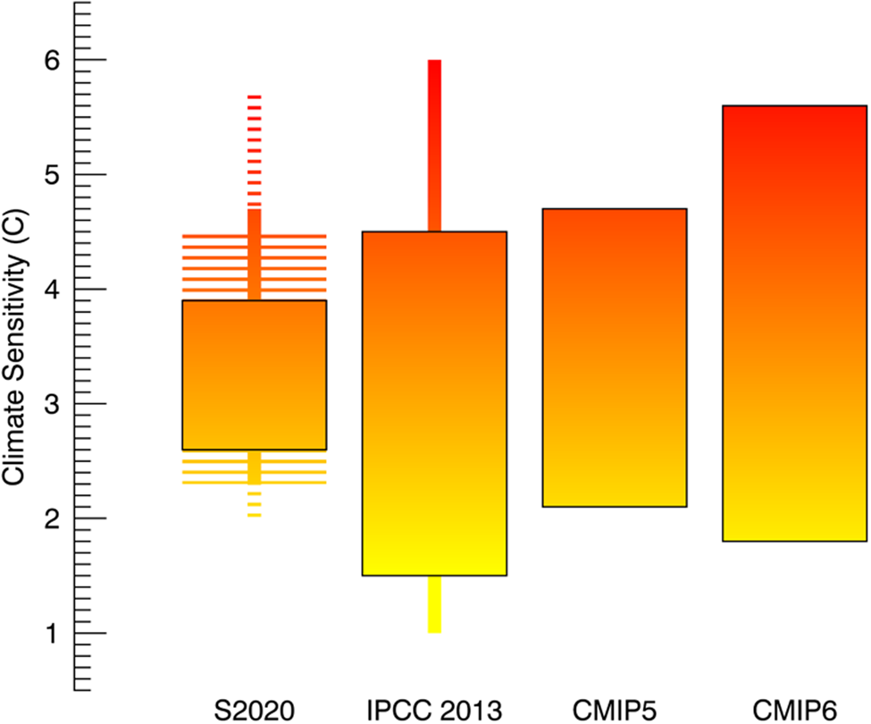
New insights in climate science in 2020
Scientific Achievement LLNL scientists and their colleagues have synthesized the past year’s top 10 policy-relevant findings in climate change science. Among them is a substantial increase in clarity regarding climate sensitivity – the global temperature response to doubled CO₂. Specifically, the likely range of climate sensitivity has been narrowed to 2.3–4.5°C by a new, comprehensive analysis of evidence from climate feedback processes, the historical record, and the paleoclimate record (Sherwood et al., 2020). Significance & Impact
Narrowed bounds on climate sensitivity represents substantial progress, simultaneously ruling out low climate sensitivities implying reduced urgency in reducing CO₂ emissions and high sensitivities implying futility in attempts to mitigate climate change. The resultant scientific horizon scan forms the basis of a wider research synthesis report provided annually to the United Nations Framework Convention on Climate Change Secretariat in connection with the Conferences of Parties.
The climate sensitivity range from Sherwood et al. (2020) exhibits much less spread than previous assessments or climate model ensembles. The 1st entry shows 66% (thick bar) and 90% (thin bar) probability ranges from Sherwood et al., with hatched extensions bounding the span of these ranges under plausible alternative assumptions. The 2nd bar shows the ≧ 66% (thick bar) and ≧ 90% (thin bar) probability ranges from IPCCs AR5 report in 2013. The last two bars show the full span of values predicted by global climate models.
Research Details An expert elicitation process was performed to identify areas of climate science in which there have been significant advances since mid-2019. A team of experts then synthesized these 10 key insights, which span a broad disciplinary scope of climate science.
Pihl, E., et al. including M. D. Zelinka, 2021: 10 New Insights in Climate Science 2020 – a Horizon Scan, Global Sustainability, 4, e5, 1–18, doi:10.1017/sus.2021.2.
Notes:
The Science
A large team of researchers has synthesized the past year’s top 10 findings across the interdisciplinary arena of climate change science in an effort to provide science-based insights that should guide climate policy. Among the 10 new scientific insights identified via expert elicitation is a substantial increase in clarity regarding climate sensitivity – the equilibrated response of global surface temperature to doubled atmospheric carbon dioxide. Specifically, the likely range of climate sensitivity has now been narrowed from 1.5–4.5°C in the most recent IPCC assessment to 2.3–4.5°C by a new, comprehensive analysis of evidence from climate feedback processes, the historical record, and the paleoclimate record (Sherwood et al., 2020).
The Impact The 10 new insights are of critical importance for evidence-based policymaking. Among these, narrowing the bounds on climate sensitivity represents substantial progress on a long-standing uncertainty in climate science, largely ruling out low climate sensitivities that would imply reduced urgency in reducing carbon emissions while also largely ruling out high sensitivities that would imply that attempts to mitigate climate change are futile. The resultant scientific horizon scan forms the basis of a wider research synthesis report provided annually to the United Nations Framework Convention on Climate Change Secretariat in connection with the Conferences of Parties.
Summary A synthesis is made of ten fields within climate science where there have been significant advances since mid-2019, through an expert elicitation process with broad disciplinary scope. Findings include: (1) a better understanding of equilibrium climate sensitivity; (2) abrupt thaw as an accelerator of carbon release from permafrost; (3) changes to global and regional land carbon sinks; (4) impacts of climate change on water crises, including equity perspectives; (5) adverse effects on mental health from climate change; (6) immediate effects on climate of the COVID-19 pandemic and requirements for recovery packages to deliver on the Paris Agreement; (7) suggested long-term changes to governance and a social contract to address climate change, learning from the current pandemic, (8) updated positive cost–benefit ratio and new perspectives on the potential for green growth in the short- and long-term perspective; (9) urban electrification as a strategy to move towards low-carbon energy systems and (10) rights-based litigation as an increasingly important method to address climate change, with recent clarifications on the legal standing and representation of future generations.

