Slide 1
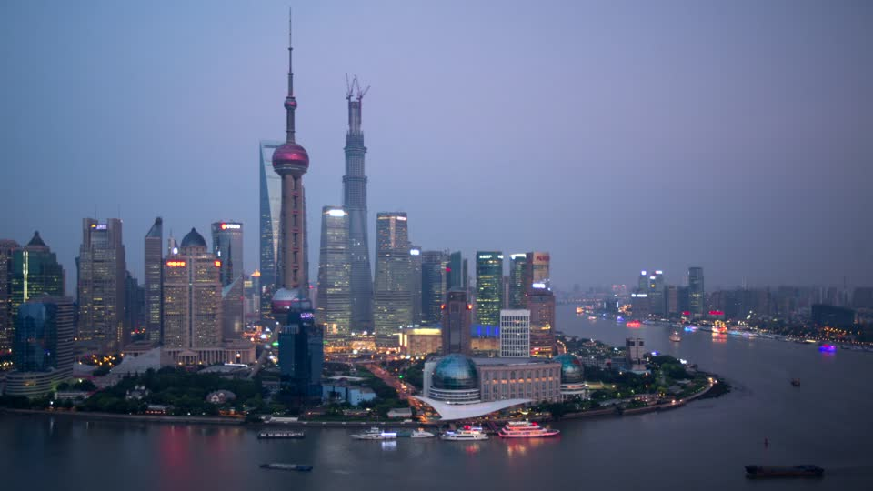
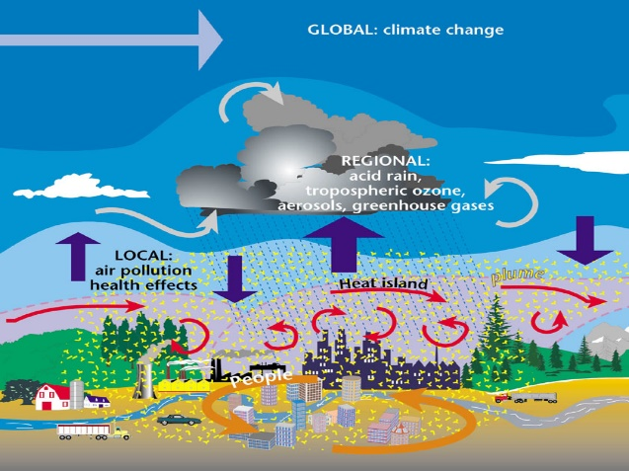
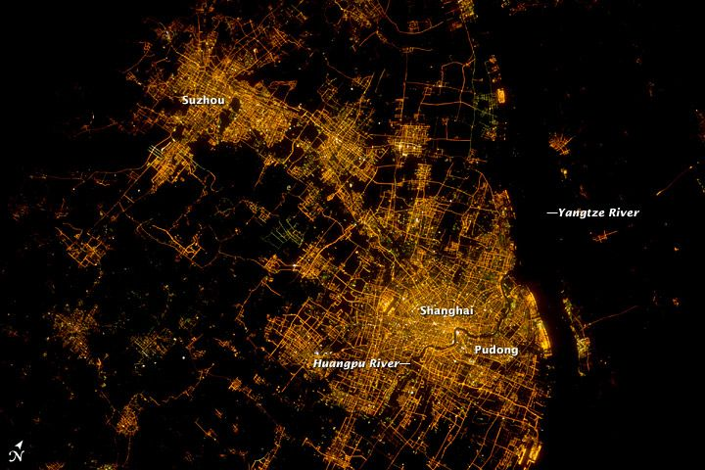
Extremes: How Booming Cities Influence Climate
Objective
Investigate the combined urban heat island and aerosol effects induced by city growth in the Yangtze River Delta region of eastern China
Approach
Conducted three, five-year cloud-permitting simulations using the Weather Research and Forecasting-Chem model coupled with a single-layer, urban canopy model
Used high-resolution nightlight image from satellite to re-grid and obtain high-resolution urban area and intensity data, and correct emission data
LEFT: Shanghai, home to 24 million people, is the center of the Yangtze River Delta megacity cluster region in eastern China. ABOVE: The cycle of how urbanization affects climate.
Impact
The urban heat island (UHI) effect increases the intensity of heat waves, as well as storms’ frequency in summer
Pollution particles tend to suppress the UHI effect
Combined effects of the UHI and aerosols on precipitation depend on synoptic (large-scale) conditions in individual rainfall events
Zhong S, Y Qian, C Zhao, LR Leung, H Wang, B Yang, J Fan, H Yan, X-Q Yang, and D Liu. 2017. “Urbanization-Induced Urban Heat Island and Aerosol Effects on Climate Extremes in the Yangtze River Delta Region of China.” Atmospheric Chemistry and Physics 17:5439-5457. DOI: 10.5194/acp-17-5439-2017
Notes:
http://www.pnnl.gov/science/highlights/highlights.asp?division=749

