Slide 1
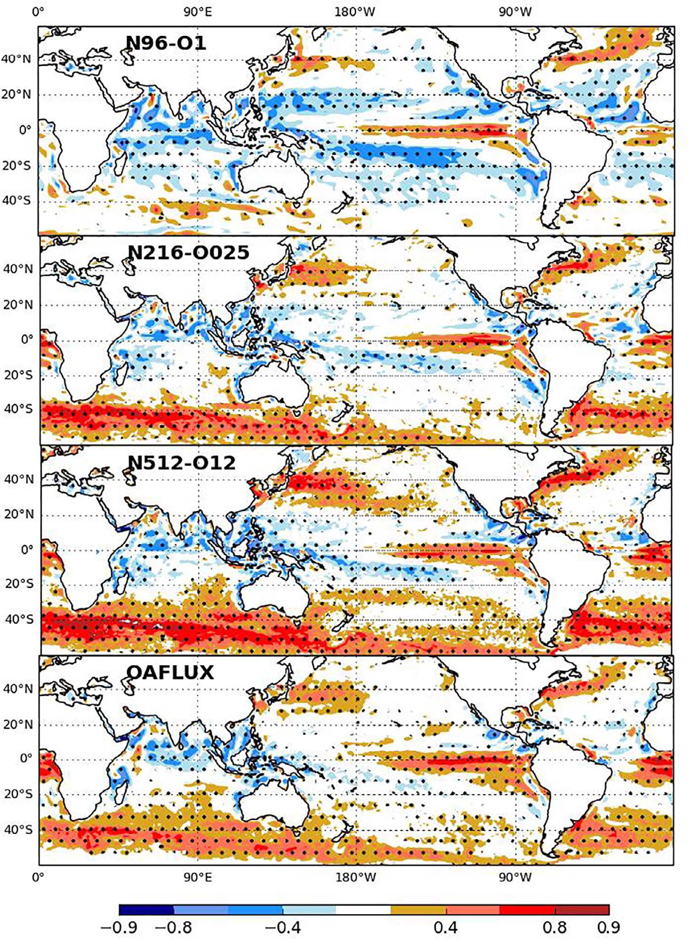
Review Article: Will high-resolution global ocean models benefit coupled predictions on short-range
to climate timescales?
Fig. 6. Temporal correlation of the monthly mean of spatially-filtered daily anomalies of SST and wind stress from models and observations. Models (atmosphere- ocean resolution) are: N96-O1, 130 km-1°; N216-O025, 60 km-0.25°; N512-O12, 25 km-1/12°; Observations OAFLUX (Yu et al., 2008). Positive correlations imply that the ocean is forcing the atmosphere. Adapted from Roberts et al. (2016, GRL)
Objective
Review benefits of the explicit resolution of mesoscale eddies, narrow boundary currents and their frontal structures, and topographic-flow interactions in the ocean components of global coupled models.
Impact
Mesoscale oceanic eddies impact both the atmospheric boundary layer and above, as well as extra-tropical storm tracks.
Explicitly resolved mesoscale eddies reduce subsurface ocean model warming drifts.
The energy cycle and meandering state of the Kuroshio Extension was found to be strongly dependent on mesoscale eddy-atmosphere feedbacks.
Approach
Synthesize published results from:
Forced ocean/sea simulations
Studies of the sea surface temperature needed to impact atmospheric simulations
Coupled models.
Hewitt, H.T., M.J. Bell, E.P. Chassignet, A. Czaja, D. Ferreira, S.M. Griffies, P. Hyder, J.L. McClean, A.L. New, M.J. Roberts, Will high-resolution global ocean models benefit coupled predictions on short-range to climate timescales? Ocean Modelling, 120, 120-136, 2017

