Slide 1
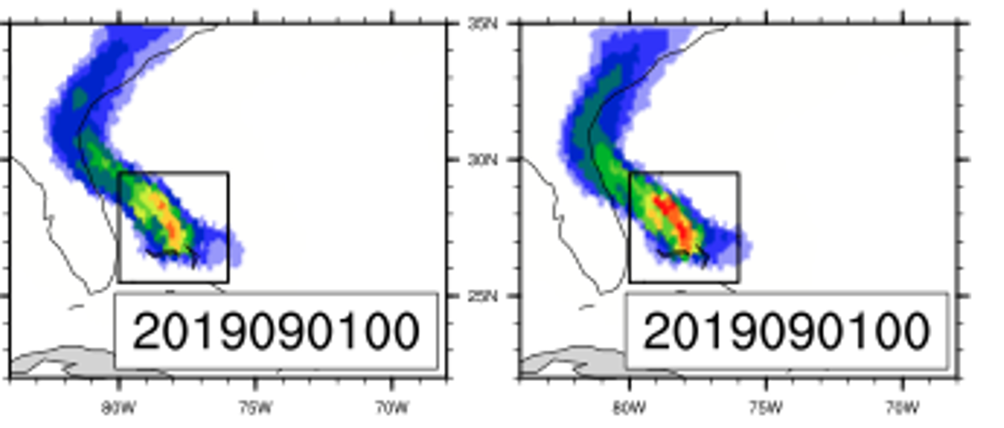
Anthropogenic Influence on Hurricane Dorian's Extreme Rainfall
The work explores the potential impact of climate change on the rainfall associated with Hurricane Dorian using the CAM5 hindcast attribution framework. The analysis indicates that the simulated extreme 3 hourly rainfall rates associated with Hurricane Dorian increase in both frequency and magnitude due to climate change. The likelihood of 3 hourly rainfall accumulations above 0.136 m (observed) increases by 16%.
Tropical cyclones are very costly natural disasters due to a diverse set of impacts, including high winds, extreme rainfall, storm surge, and fresh and/or saltwater flooding. A recent review by estimates that the global mean near-storm rainfall increases at the Clausius-Clapeyron rate of about 7% per 1°C. This work continues the authors’ advances in attribution frameworks to quantify the effect of climate change on individual hurricanes
This work uses the variable-resolution configuration of the Community Atmosphere Model version with a 28-km nest over the North Atlantic to construct a hindcast ensemble under "actual" and counterfactual climate and weather conditions. The anthropogenic signal for the counterfactual hindcast is approximated by computing the difference between the All-Hist and Nat-Hist simulations completed under DOE RGMA sponsored Climate of the Twentieth Century (C20C+) Detection and Attribution Project (available at portal.nersc.gov/c20c) for the average of August and September over 1996-2016.
Total accumulated ensemble mean storm-related rainfall (m) over the entire forecast period (excluding the first 12 hours) of the counterfactual and actual realizations of Hurricane Dorian for a single initialization time.
K. A. Reed, M. F. Wehner, A. M. Stansfield and C. M. Zarzycki (2021), Anthropogenic Influence on Hurricane Dorian’s Extreme Rainfall, [in “Explaining Extremes of 2019 from a Climate Perspective”]. Bull. Amer. Meteor. Soc., 102 (1), S9–S15, doi:https://doi.org/10.1175/BAMS-D-20-0160.1. (Cover article)

