Slide 1
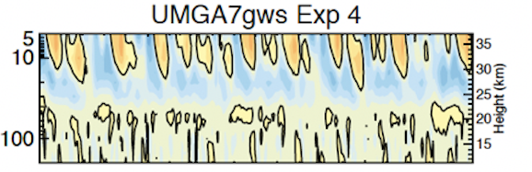
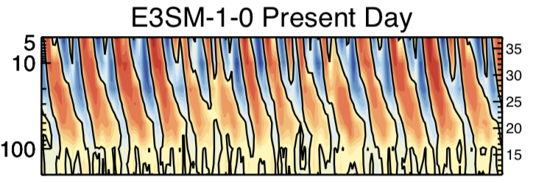
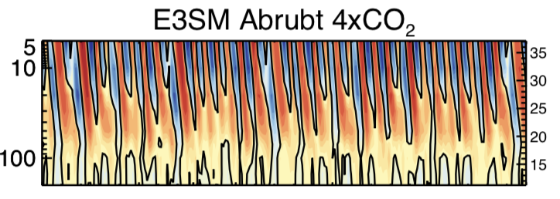
Response of the quasi-biennial oscillation to a warming climate in global climate models
Jadwiga (Yaga) H. Richter and Coauthors (2020): Quarterly Journal of the Royal Meteorological Society: Special Section QBO Modelling Intercomparison. https://doi-org.cuucar.idm.oclc.org/10.1002/qj.3749
Present Climate
4 x CO₂
OBJECTIVE
We examine the response of the quasi-biennial oscillation (QBO) of the tropical stratospheric winds to doubled and quadrupled CO₂ climates.
APPROACH
Eleven atmosphere general circulation models have performed simulations with 2xCO₂ and SSTs+2K, and 4xCO₂ and SSTs+4K.
IMPACT
We find that there is no consistency among climate models with regard to how the QBO will change in the warming climate. In the quadrupled CO₂ simulations, a reduction in the QBO period to 14 months was found in some models, whereas in several others the tropical oscillation completely disappeared. In contrast, all the models projected a decrease in the QBO amplitude in a warmer climate. More research is needed on how large-scale tropical waves (Kelvin and mixed-Rossby GWs) as well as small scale gravity waves will change in warming climate to assess how the QBO and its impacts will change in future climate.
Zonal mean zonal wind averaged between 5ºS and 5ºN as a function of pressure and time for Exp 2 (present day) and Exp 4 (4xCO₂, SSTs+4K) for three selected QBOi models + E3SM (present day and Abrubt 4xCO₂)

