Slide 1
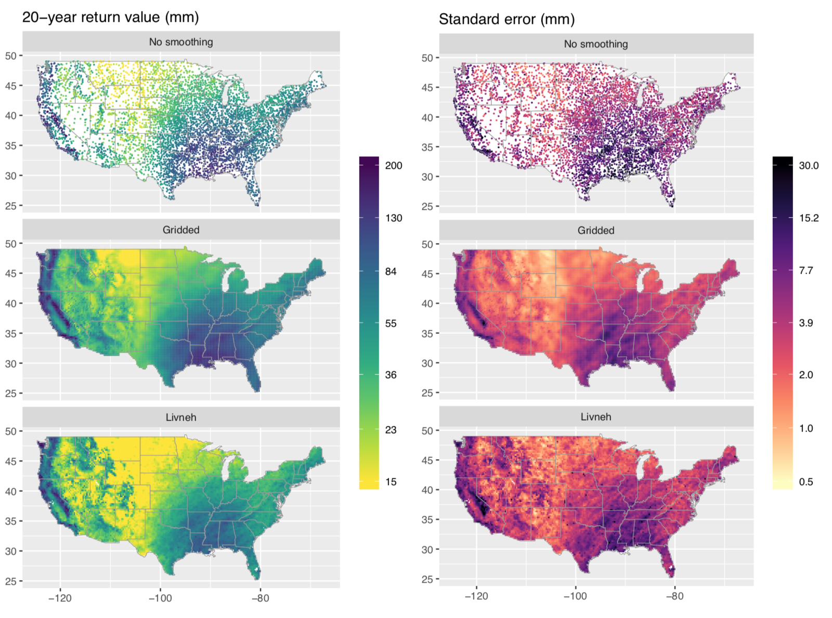
A probabilistic gridded product for daily precipitation extremes over the United States
A specialized statistical analysis is used to characterize the climatology of extreme precipitation over CONUS as follows: first, estimate the extreme climatology of precipitation based on station data, and then use a data-driven statistical approach to interpolate the estimates to their native scales and quantify the resulting uncertainty.
We present a new gridded product with uncertainty based on in situ measurements specifically tailored to extreme precipitation. Our analysis demonstrates how to properly compare station data with output from climate models, and we show that traditional products underestimate extreme wintertime precipitation by an average of 27%.
Top: DJF 20-year return values (left) with uncertainty (right), showing that our new data product (middle row, “Gridded”) is consistent with station-specific estimates (top row, “No smoothing”) but has greatly reduced uncertainty. Bottom row: Livneh estimates.
Bottom: Illustration of the dry bias in precipitation extremes from the Livneh et al. (2013) data set (average = 27%), relative to our data product.
Analyses conducted using state-of-the-art extreme value statistical methods
Data-driven uncertainty quantification to indicate where the gridded product is more or less certain
Accounts for temporal changes and seasonal differences in the climatology of extreme precipitation
Describes the relationship between extreme precipitation and orography, as well as the spatial length scale of extreme precipitation
Risser, M. D., Paciorek, C. J., Wehner, M. F., O’Brien, T. A., Collins, W. D. (2019). A probabilistic gridded product for daily precipitation extremes over the United States. Climate Dynamics, just-accepted. https://doi.org/10.1007/s00382-019-04636-0

