Slide 1
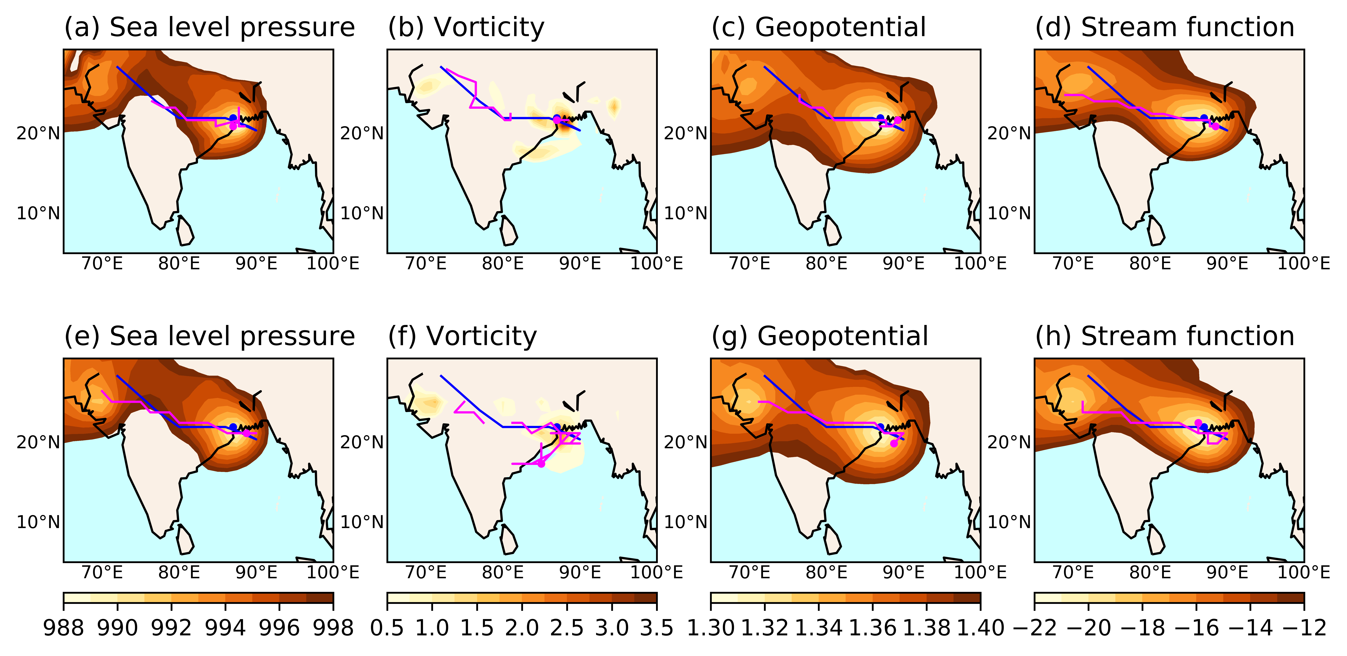
Creating and analyzing an optimal, global dataset of atmospheric vortices in monsoon regions
Objective
Create a fast, objective, optimal algorithm to identify monsoon low pressure systems in ensembles of high-resolution data
Approach
Execute over 500 algorithms on four modern atmospheric reanalyses, choosing the algorithm that best matches a hand-analyzed reference dataset while minimizing disagreement between reanalyses
Assess trends and interannual variability in the resulting track datasets
Impact
The resulting data product provides a new basis for understanding vortices that produce extreme rainfall in Earth’s tropics
A previously claimed large decrease in South Asian monsoon depressions was shown to likely be an artifact of the introduction of satellite observations in the early 1980s
The optimized algorithm can be used in supercomputing environments to assess future trends in high-resolution Earth system model output
Illustration of the algorithm optimization process, testing skill using four geophysical variables in two atmospheric reanalyses. The vortex genesis point and track obtained by the algorithm are shown in magenta, while the genesis point and track from the subjectively analyzed reference dataset are shown in blue. The top panel shows results from ERA–Interim and the bottom panel from JRA-55.
Vishnu, S., W. R. Boos, P. A. Ullrich, and T. A. O'Brien. "Assessing historical variability of South Asian monsoon lows and depressions with an optimized tracking algorithm." Journal of Geophysical Research: Atmospheres: DOI: 10.1029/2020JD032977

