Slide 1
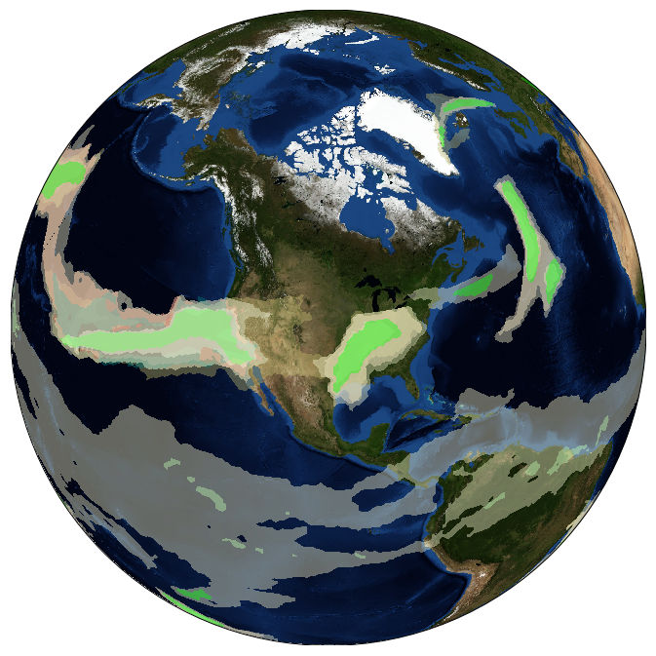
Defining Uncertainties Through Comparison of Atmospheric River Tracking Methods
Objective
Present outcomes from the 2nd ARTMIP (Atmospheric River Tracking Method Intercomparison Project) Workshop, held April 23 -24th in Gaithersburg Maryland, sponsored by the RGCM DOE program.
ARTMIP aims to quantify the uncertainty in AR climatology, precipitation, and related impacts that arise from a wide range of AR tracking methods developed by the community, and how these AR-related metrics may change in the future.
The goal of the workshop was to discuss results and chart a path forward.
A visual representation of multiple atmospheric river detections for February 7, 2017 at 0600 UTC. Values are shaded where an individual ARTMIP algorithm detects an AR, and each ARTMIP algorithm is randomly assigned a distinct color with a low opacity. Areas with all algorithms agreeing on AR detection appear perfectly opaque, areas with all algorithms agreeing on a lack of AR presence simply show the background 'blue marble' image, and areas with some amount of algorithm disagreement on AR presence appear semi-translucent. Credit: Travis O’Brien
Approach
The two-day workshop included participants from various U.S. federal agencies/programs, national and international universities, and U.S. national labs.
Presentations on the state of AR science and various aspects of current ARTMIP analysis were given.
Participants were given a forum to discuss results from the 1st phase of the project (Tier1, using MERRA-2 data).
Detailed plans were made for the 2nd phase (Tier 2, using climate change model data and reanalysis sensitivity).
Impact
Metrics and analysis discussed for Tier 1 data (including AR frequency, duration, intensity), will be used to craft guidance and recommendations on choice of methodology for specific science questions. Advantages and disadvantages for classes of algorithms will greatly help individual AR resources choose an appropriate methodology for their science problem.
A database of AR catalogues will be available to the community to further AR research
Gaps and emerging needs for advancing AR tracking were discussed and reported.
Shields, C.A., J.J. Rutz, L.R. Leung, F.M. Ralph, M. Wehner, T. O’Brien, and R. Pierce, 0: Defining Uncertainties Through Comparison of Atmospheric River Tracking Methods. Bull. Amer. Meteor. Soc., 0, https://doi.org/10.1175/BAMS-D-18-0200.1

