Slide 1
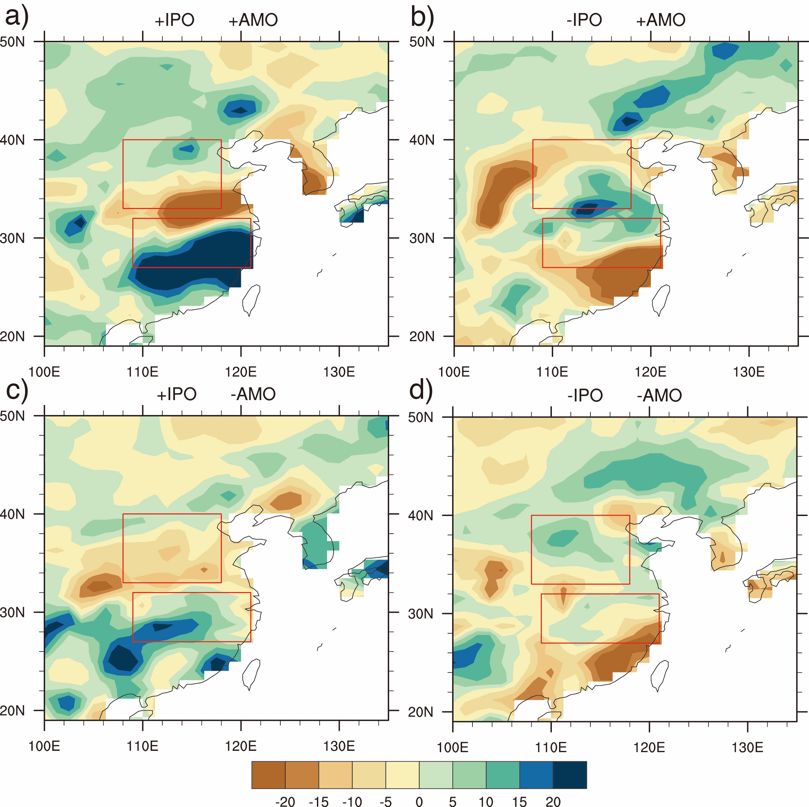
Internally generated and externally forced multidecadal oceanic modes and their influence on the summer rainfall over East Asia
Objective
The interdecadal oceanic variabilities can be generated from both internal and external processes, and these variabilities can significantly modulate our climate on global and regional scale, such as the warming slowdown in the early 21st century, and the rainfall in East Asia. Here, we study whether the Interdecadal Pacific Oscillation (IPO) and the Atlantic Multidecadal Oscillation (AMO) are primarily internally generated oceanic variability, or oceanic variability generated by internal oceanic processes and modulated by external forcings. We further study how these mode variability will affect the East Asia summer rainfall.
Figure 1. Composite summer rainfall anomalies over East Asia for warm and cold phases of IPO and AMO in the control run. (a) warm IPO, warm AMO; (b) cold IPO, warm AMO; (c) warm IPO, cold AMO; (d) cold IPO, cold AMO.
Approach
Community Earth System Model version 1 (CESM1) with 1 degree resolution is our tool.
1800-hundred year 1850 preindustrial control run
40 member ensemble simulations with time-evolving 20th century all known forcings (1920-2005), and RCP8.5 forcings (2006-2013).
Climate modes: IPO and AMO
East Asia summer rainfall
Impact
Our results show that IPO is primarily an internal ocean mode, but AMO is an internal ocean mode with significant modulation from external forcings.
CESM1 can simulate the observed relationship between IPO and East Asian summer rainfall well in both preindustrial control and 20th century ensemble, but could not simulate the time evolution of IPO in 20th century. Although CESM1 failed to simulate the relationship of AMO and east Asia summer rainfall in the control, it does for the 20th century.
Si, D. and A. Hu, 2017: Internally generated and externally forced multidecadal oceanic modes and their influence on the summer rainfall over East Asia. J.Climate. doi:10.1175/JCLI-D-17-0065.1, in press.

