Slide 1
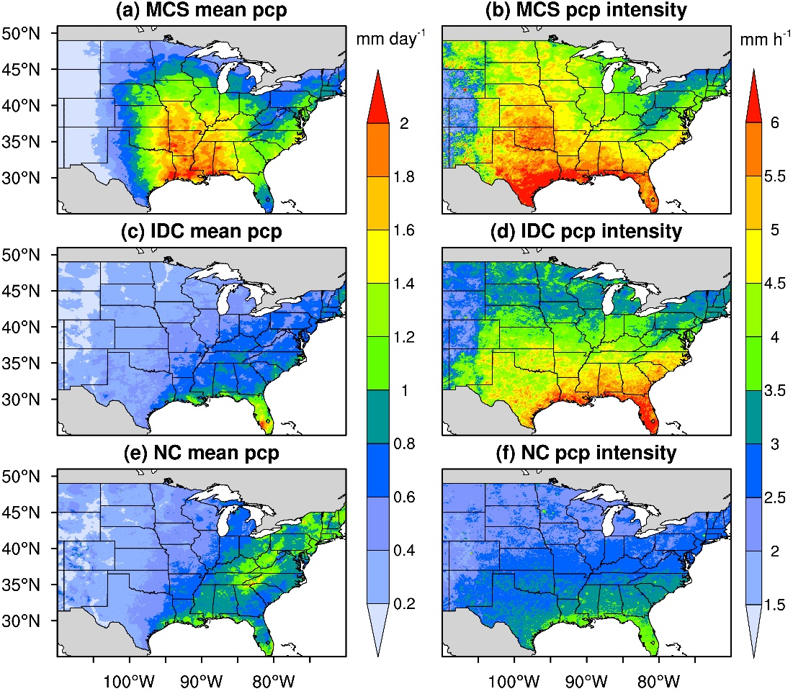
A Novel Dataset for Better Understanding Different Convective Systems
Objective
Develop a high-resolution observational data product that tracks mesoscale convective systems (MCSs) and isolated deep convection (IDC) in the U.S.
Approach
Update the Flexible Object Tracker algorithm to track both MCS and IDC events.
Run the Flexible Object Tracker algorithm to produce an observational data product of MCS and IDC in the U.S. at a 4-km, hourly resolution from 2004–2017.
Evaluate the climatological characteristics of MCSs and IDC, as well as their contributions to U.S. precipitation.
Impact
The new product will enable research on the evolution and environments of MCSs/IDC and how they impact surface hydrology, atmospheric chemistry, and severe weather hazards.
It provides a benchmarking dataset to evaluate and improve the representation of MCS/IDC processes in weather and climate models.
Distributions of mean precipitation and precipitation intensities for different precipitation types (MCS, IDC, non-convective [NC]) over the US. The maps show the significant differences in magnitude and spatial patterns of the different precipitation types.
Li J., Z. Feng, Y. Qian, and L. R. Leung 2021. “A high-resolution unified observational data product of mesoscale convective systems and isolated deep convection in the United States for 2004-2017.” Earth Syst. Sci. Data, 13, 827–856. [DOI: 10.5194/essd-13-827-2021]

