Slide 1
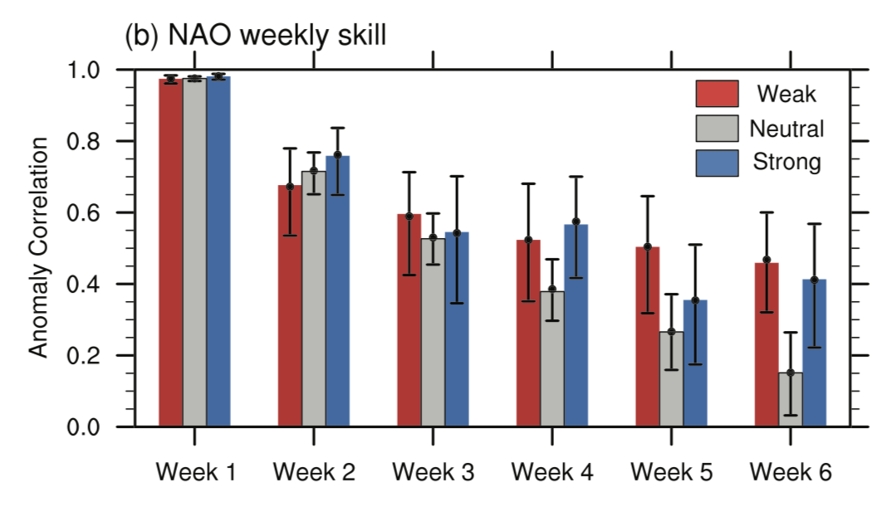
Attribution of NAO Predictive Skill Beyond 2 Weeks in Boreal Winter
L. Sun, J. Perlwitz, J.H. Richter, M. P. Hoerling, J.W. Hurrell (2020): GRL: https://doi.org/ 10.1029/2020GL090451
OBJECTIVE
To quantify the predictive skill of the North Atlantic Oscillation (NAO) for lead times of 3-6 weeks coming from the stratosphere and from the El Nino-Southern Oscillation (ENSO)
ACC of NAO
APPROACH
We examined a 20-member ensemble of 45-day initialized reforecasts over the period from 1999-2015 together with uninitialized simulations forced with observed radiative and lower boundary conditions with the Community Earth System Model, version 1 (CESM1)
IMPACT
Winter climate over Europe and eastern North America is significantly affected by the variability of the NAO. We find that CESM1 is able to better predict the NAO up to 3 weeks following extreme weak or strong states of the stratospheric polar vortex compared to stratospheric neutral vortex states. Enhanced weeks 3-6 NAO predictive skill for weak vortex events results primarily from stratospheric coupling to the troposphere, while enhanced skill for strong vortex events can be attributed in part to ENSO.
Weekly NAO skill for the weak (red), strong (blue) stratospheric polar vortex events and neutral polar vortex conditions (gray). Error bars indicate the 5% and 95% statistical significance levels.

