Slide 1
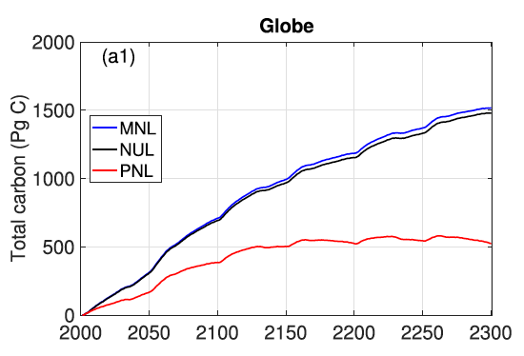
Numerical Coupling Strongly Influences Simulated Land Carbon Dynamics
Scientific Achievement
Land models rely on a variety of numerical implementations of soil biogeochemistry
We show different numerical implementations result in uncertainty as large as inter-model differences
Significance and Impact
The popular mineral nutrient limitation (MNL) algorithm over-estimated model sensitivity
The multi-substrate co-limiting algorithm (PNL) overcomes numerical uncertainty common in traditional methods
Figure. Differences between three numerical coupling schemes in total land carbon stock responses to RCP4.5 atmospheric CO₂ forcing. The simulations ere performed with ELMv1 coupled to the soil reactive transport solver BeTR.
Research Details
We implemented several numerical coupling schemes using the DOE E3SM land model (ELMv1)
We analyzed how different coupling methods affect simulated land carbon dynamics
We show traditional methods overestimate CO₂ sensitivity
We applied the improvements to ELMv1
Tang, J.-Y. and Riley, W. J.: Predicted land carbon dynamics are strongly dependent on the numerical coupling of nitrogen mobilizing and immobilizing processes: A demonstration with the E3SM land model, Earth Interactions, doi: 10.1175/EI-D-17-0023.1, 2018 .

