Slide 1
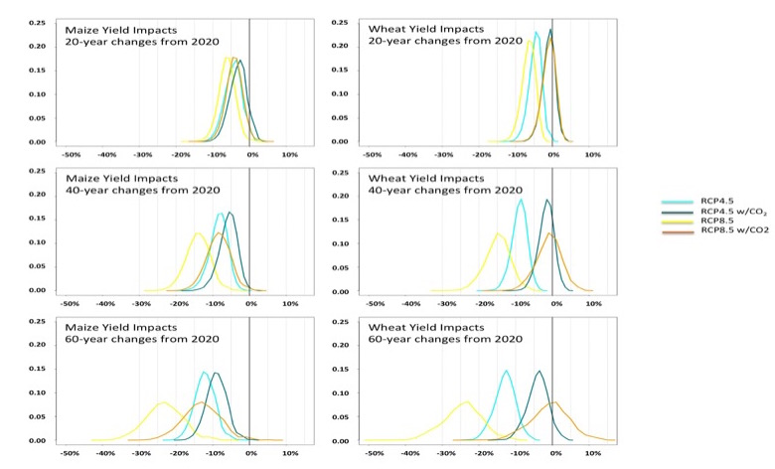
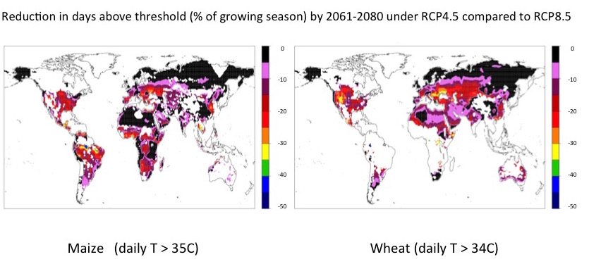
Estimated impacts of emission reductions on wheat and maize crops
Objective: We want to quantify the impacts associated with different emission scenarios on agricultural productivity, of particular interest for food insecure populations.
Part of a larger project: Benefits of Reduced Anthropogenic Climate changE (BRACE) which compares physical and societal impacts under two alternative future climate change pathways. https://chsp.ucar.edu/brace
Approach: Fit empirical relation between temperature and precipitation (accounting for regional distribution of production and growing season) and crop yields (global, annual) on the basis of observed data.
Aggregate temperature and precipitation model output over same regions/seasons, use empirical relation to derive future yield changes.
Incorporate CO₂ fertilization effects.
Also consider exposure to damaging heat and its changes in the future (no yield impacts though).
Look at different statistics/time horizons for both RCPs and compute avoided impacts/benefits of mitigation.
Significance: Substantial benefits from mitigation would be achieved throughout the 21st century in terms of
*reducing the expected size of average losses in productions,
*reducing chances of major slowdowns over short periods of time, and
*reducing exposure to potentially catastrophic heat during the critical period of the growing seasons.
The effects of CO₂ fertilization temper the gains from mitigation for the C3 crop, wheat, while benefits remain significant for maize (a C4 crop) yields.
Tebaldi, C. and D. Lobell, 2015: Estimated impacts of emission reductions on wheat and maize crops Climatic Change (online first) doi:10.​1007/​s10584-015-1537-5

