Slide 1
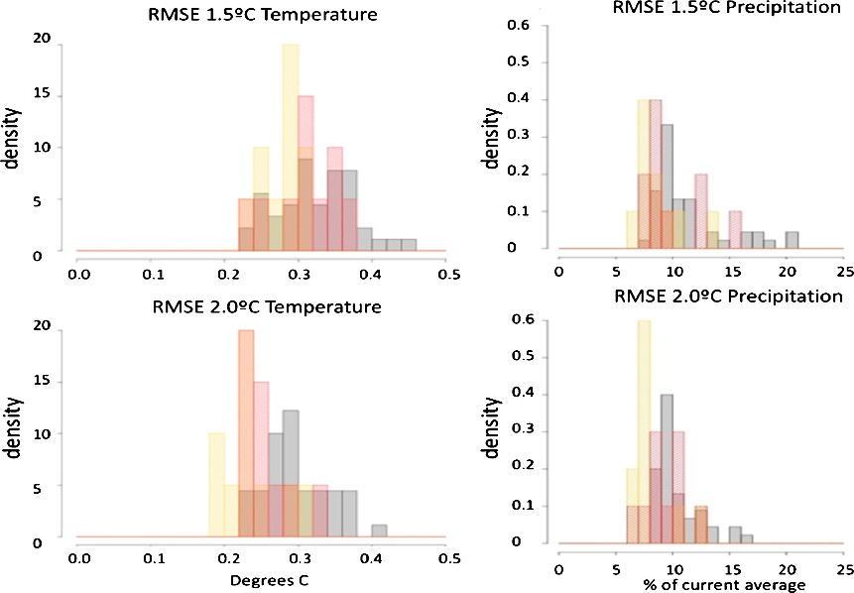
Evaluating the accuracy of climate change pattern emulation for low warming targets
Objective: Analyze the performance of emulator techniques in approximating average temperature and precipitation model output for the low-warming scenarios motivated by the Paris targets, using pre-existing higher scenario simulations.
Research: We apply established emulator techniques (pattern scaling and time-shift) to an ensemble of RCP4.5 simulations of surface temperature and precipitation from CESM1, approximating the output of the same model under the 1.5C and 2C warming levels, for which we have the true outcomes for comparison. We establish that the error introduced by the emulation is within the margin of errors introduced by the model internal variability, and pales in comparison to multi-model structural uncertainties. We also propose and test the performance of a simple emulation technique for interannual variability, which may be important when applying this type of output to impact modeling.
Histograms of Root Mean Square Error for the errors produced by approximating the 1.5 °C and 2.0 °C scenarios' temperature and percent precipitation change fields by RCP4.5 pattern scaled (yellow), or using the time shift approach (red). Results are for 10 ensemble members of the CESM simulations. The black histograms show the size of the RMSEs when comparing patterns from the true scenario simulations across the ensemble members, as a measure of internal variability.
Impact: We show that in the lack of actual model simulation addressing the Paris targets, simple and well established simulation techniques, previously applied to higher scenario, can be safely used to approximate low-warming, high mitigation scenario. The techniques can be used to recreate multi-model suite of outcomes exploring uncertainties beyond internal variability.
Tebaldi, C. and R. Knutti, 2018: Evaluating the accuracy of climate change pattern emulation for low warming targets. Env. Res. Lett., http://iopscience.iop.org/article/10.1088/1748-9326/aabef2

