Slide 1
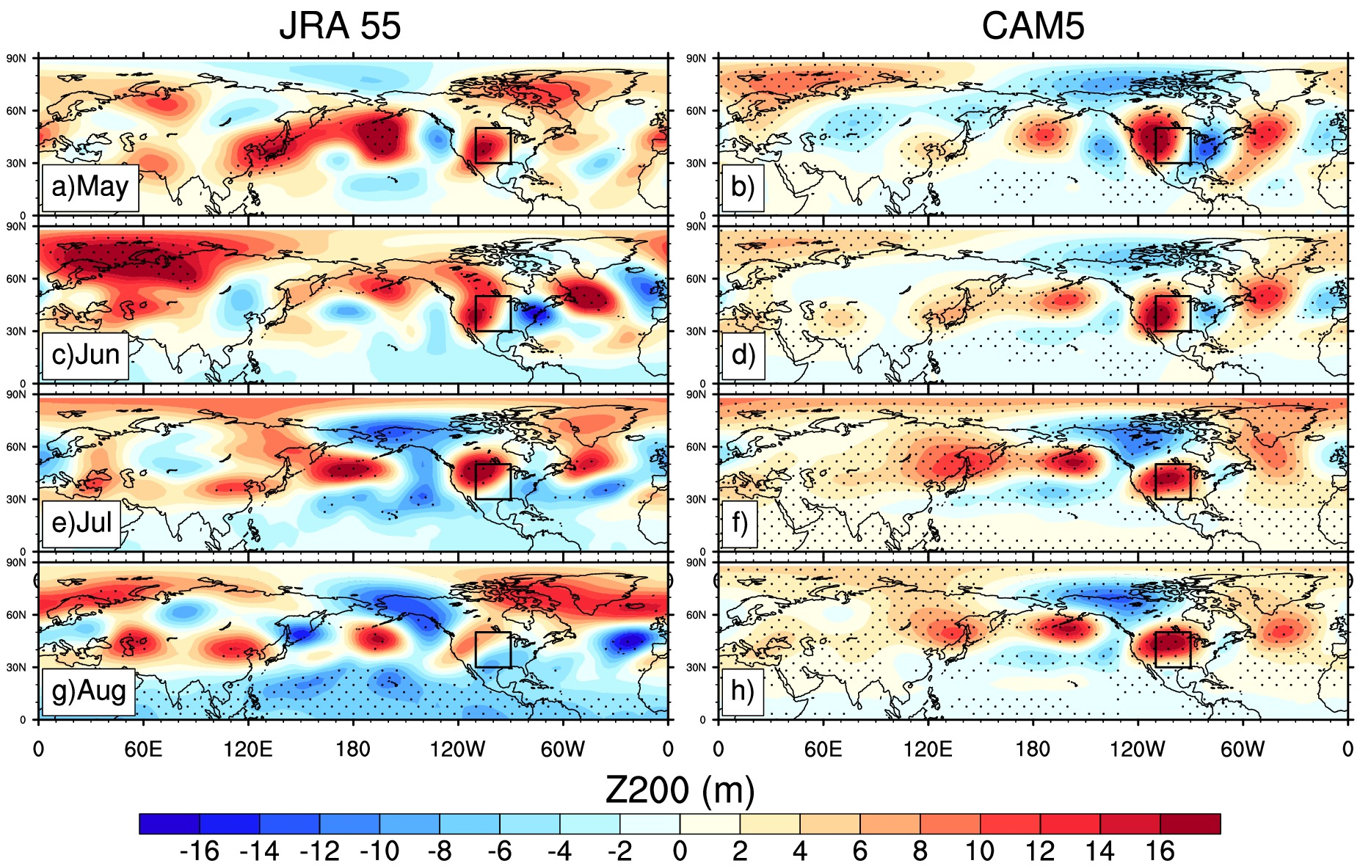
Circumglobal Response to Prescribed Soil Moisture
over North America
Haiyan Teng, Grant Branstator, Ahmed Tawfik and Patrick Callaghan
Objective
Find sources of predictability for high-impact stationary wave anomalies observed in recent boreal summers
Approach
A series of idealized prescribed soil moisture experiments with CESM1 atm/lnd stand-alone configuration
A linear planetary wave model
Impact
The first systematic investigation of soil moisture’s impact on large-scale circulation with CESM1
Improved dynamical understanding of circumglobal teleconnections in the boreal summer
Discovered a new source of extended predictability for high-impact stationary wave events
Regressed Z200 upon domain averaged soil moisture in the Great Plains box in JRA-55 (left) and the 2600-year CAM5 control run (right) during May, June, July and August.
Teng, H., G. Branstator, A. B. Tawfik, and P. Callaghan, 2019: Circumglobal response to prescribed soil moisture over North America. J. Climate, DOI: 10.1175/JCLI-D-18-0823.1

