Slide 1
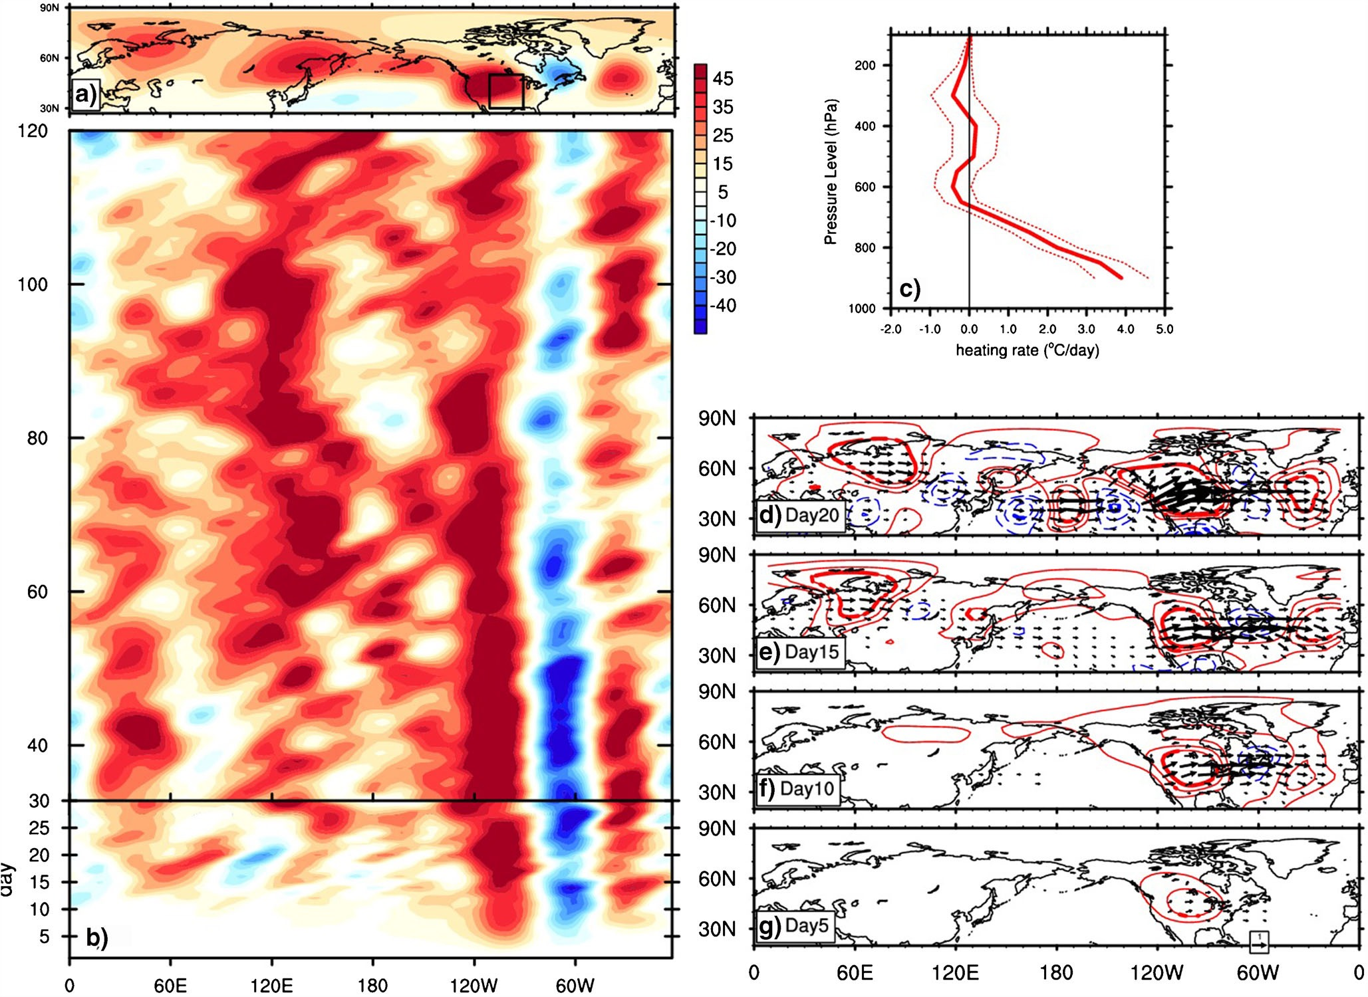
Amplification of Waveguide Teleconneciton
in the Boreal Summer
Teng H. and G. Branstator, 2019, Current Climate Change Report, 5:421-432
OBJECTIVE
Synthesize and discuss the limitations of the prevailing hypotheses on whether climate change can amplify quasi-stationary Rossby wave events, leading to more extreme events in the mid-latitude.
APPROACH
In-depth review
IMPACT
The Quasi-resonant Amplification(QRA) hypothesis (Petoukhov et al. 2013) has not yet been verified with models
Enhanced diabatic heating, particularly that associated with increasing aridity in the mid-latitude, if properly modeled, could lead to more high-amplitude circumglobal planetary wave events
a) Seasonal mean response of 300 hPa geopotential height (Z200) in the 100 member CESM1 Great Plains soil water depletion experiment and b) Hovmoller diagrams of daily Z200 anomalies averaged at 40-60N. c) Vertical profiles of seasonal mean diabatic heating anomalies averaged at the Great Plains box (outlined in a), where soil water was depleted, with the solid and dashed lines representing the 100-member ensemble mean and +/- 1 standard deviation, respectively. g,f,e,d are daily Z200 anomalies and horizontal component of wave activity flux at 200 hPa on day 5, 10, 15 and 20 respectively.

