Slide 1
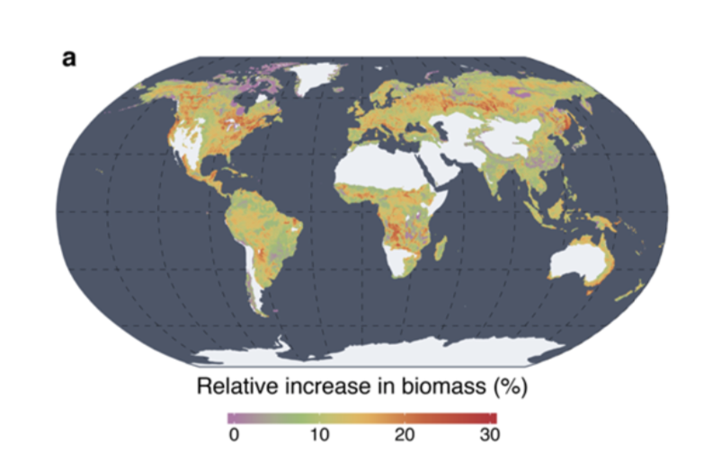
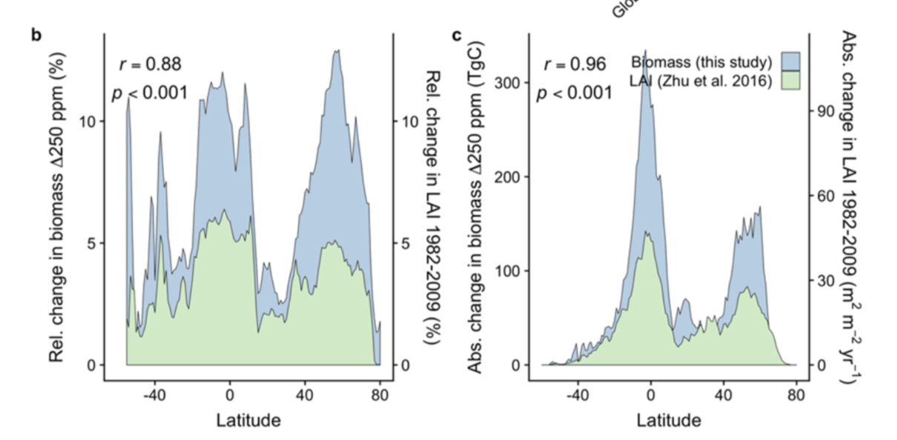
The CO₂ fertilization effect on global plant biomass
Scientific Achievement
We identify a strong effect of eCO₂ on global biomass accumulation, modulated by both climate and nutrient availability.
The response we identify from eCO₂ experiments is consistent with the global distribution of changes in LAI and Biomass observed from remote sensing, suggesting that those changes are primarily due to eCO₂.
The results suggest that CO₂ levels expected by 2100 can potentially enhance plant biomass by ~12% above current values.
Significance and Impact
These results demonstrate the potential of combining models with remote sensing observations and results from ecological experiments.
They suggest large past and potential future increases in global biomass and LAI due to the effect of elevated CO₂, emphasizing the importance of space-based monitoring in the coming decades.
Research Details
(a) Total projected biomass increase projected under moderate CO₂ increases (250 ppm above present day) derived from global eCO₂ experiments. (b,c) Comparison of the latitudinal distribution of the relative (b) and absolute (c) effect of eCO₂ on above-ground biomass (AGB) and past changes in greenness (LAI) attributed to the increase in atmospheric CO₂ in the period 1982-2009
We use ecosystem models, satellite observations, and globally distributed ground observations from eCO₂ experiments, to assess the effect of CO₂ on photosynthesis, leaf area and biomass.
We develop methods to bridge the scales between ground observations, models and satellites, to quantify the effect of CO₂ on ecosystem function.
Terrer, C., Jackson, R., Prentice, I.C., Keenan, T. F., et al. (2019) Nature Climate Change
https://doi.org/10.1038/s41558-019-0545-2

