Slide 1
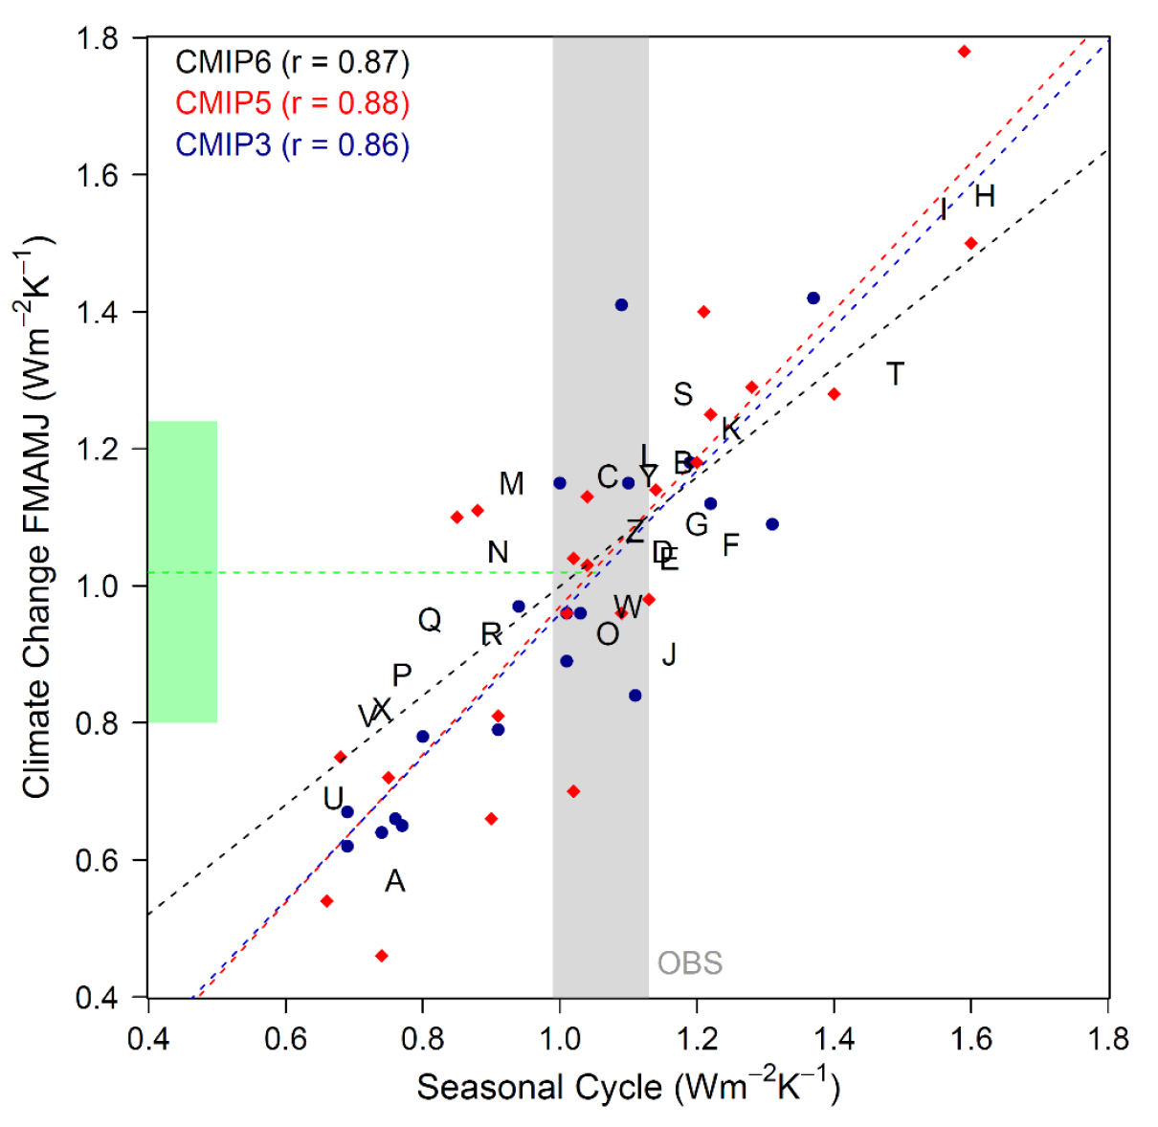
Assessing emergent constraints on surface albedo feedback in the latest Earth System Models
Scientific Achievement UCLA and LLNL scientists evaluated whether previously-identified emergent constraints on surface albedo feedback hold up in the latest generation of Earth System Models. They found that the emergent constraint for snow cover in the NH remains strong, while that for sea ice has weakened. Inter-model spread in this feedback remains largely unchanged owing to outlier models that mask improvement in many models. Significance & Impact
Out-of-sample testing – as is done here – is essential for establishing the reliability of emergent constraints, which can reduce uncertainty in climate change projections. This study confirms that the seasonal responses of snow and sea ice are highly informative about the modeled response of NH surface albedo to greenhouse warming. This means that steps to reduce the inter-model spread in the observable seasonal cycle response should bear fruit in reducing spread in this feedback.
Snow albedo feedbacks in the seasonal cycle context scattered against those under climate change, for models comprising three CMIP generations. Grey shading indicates an observational estimate using MODIS albedo. Green shading indicates the 95% prediction interval for spring snow albedo feedback under climate change.
Research Details The team compared surface albedo feedbacks operating on long timescales with those occurring each year as snow and sea ice vary seasonally in multiple generations of climate models. A high across-model correlation is found between these two types of responses in all model generations (see figure above), strongly supporting the robustness of this emergent constraint
Thackeray, C. W., A. Hall, M. D. Zelinka, and C. G. Fletcher, 2021: Assessing prior emergent constraints on surface albedo feedback in CMIP6, J. Climate, doi:10.1175/JCLI-D-20-0703.1.
Notes:
The Science
Scientists at University of California Los Angeles, Lawrence Livermore National Laboratory, and University of Waterloo have re-evaluated whether previously-identified emergent constraints on surface albedo feedback hold up in the latest generation of global Earth System Models. Such out-of-sample testing is essential for establishing the robustness and reliability of emergent constraints, which can assist in reducing uncertainty in climate change projections. The team finds that the emergent constraint for snow cover in the Northern Hemisphere remains strong in the latest model ensemble, while that for sea ice has weakened. Despite the existence of this emergent constraint over several model generations, inter-model spread in this feedback remains largely unchanged owing to outlier models that mask improvement in many models.
The Impact
The study confirms using an out-of-sample test that the seasonal responses of snow and sea ice are highly informative about the modeled response of Northern Hemisphere surface albedo to greenhouse warming. This means that steps to reduce the inter-model spread in the observable seasonal cycle response should bear fruit in reducing spread in this feedback that is very important for Arctic amplification, among other things. The team recommends that modelling centers try to reduce biases in maximum annual snow cover extent, snow-covered surface albedo, and sea ice thickness. They encourage incorporation of more cryospheric metrics into model benchmarking packages, which could facilitate modeling groups performing similar analyses during model development.
Summary
An emergent constraint (EC) is a popular model evaluation technique, which offers the potential to reduce inter-model variability in projections of climate change. Two examples have previously been laid out for future surface albedo feedbacks (SAF) stemming from loss of Northern Hemisphere (NH) snow cover (SAFsnow) and sea ice (SAFice). These processes also have a modern-day analog that occurs each year as snow and sea ice retreat from their seasonal maxima, which is strongly correlated with future SAF across an ensemble of climate models. The newly released CMIP6 ensemble offers the chance to test prior constraints through out-of-sample verification, an important examination of EC robustness. Here, we show that the SAFsnow EC is equally strong in CMIP6 as it was in past generations, while the SAFice EC is also shown to exist in CMIP6, but with different, slightly weaker characteristics. We find that the CMIP6 mean NH SAF exhibits a global feedback of 0.25 ± 0.05 Wm-2K-1, or ~61% of the total global albedo feedback, largely in line with prior generations despite its increased climate sensitivity. The NH SAF can be broken down into similar contributions from snow and sea ice over the 21st century in CMIP6. Crucially, inter-model variability in seasonal SAFsnow and SAFice is largely unchanged from CMIP5 because of poor outlier simulations of snow cover, surface albedo, and sea ice thickness. These outliers act to mask the noted improvement from many models when it comes to SAFice, and to a lesser extent SAFsnow.

