Slide 1
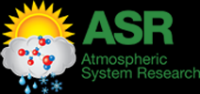
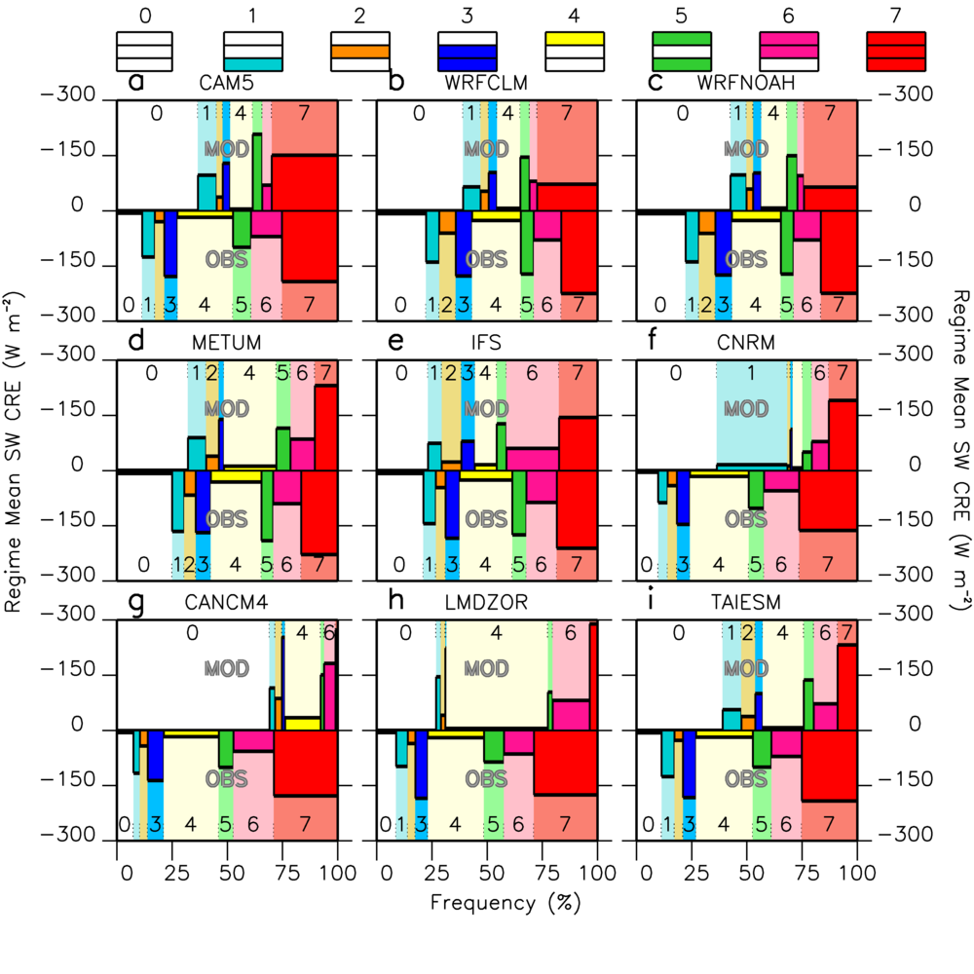
CAUSES: Attribution of Surface Radiation Biases in NWP and Climate Models near the US Southern Great Plains
RGCM
Science Question
What is the main cause of surface radiation biases in NWP and climate models in the Midwest?
Which cloud regimes contribute most to the surface radiation bias?
What can we learn in terms of parameterization development from precipitation, cloud and radiation biases?
Statistics of shortwave the Cloud Radiative Effect of 8 cloud regimes (clear sky = 0, deep cloud = 7) in 9 models. The width of each bar indicates the relative frequency of the regime. The height of the bar represents the average CRE (aCRE) when the regime is present. The total CRE of the regime is represented by the surface area of each of the bars. Modeled regime 7 (red bars, top half of each panel) has too small total CRE in most models, either due to too small frequency (e.g. CanCM4) or too small CRE (e.g. WRF CLM)
Key Accomplishments
Clouds contribute most to the shortwave radiation bias, but significant contributions from surface albedo exist.
Deep clouds are main cause of SW bias, either because missing cloud events or because underestimated aCRE
This does not mean that convection is not being triggered enough. Most models are too wet in the afternoon, but too dry at night. Precipitation efficiencies might be overestimated in convection parameterizations.
Van Weverberg, K. and coauthors (2018), CAUSES: Attribution of surface radiation biases in NWP and climate models near the US Southern Great Plains, J. Geophys. Res. Atmospheres, DOI: 10.1002/2017JD027188

