Slide 1
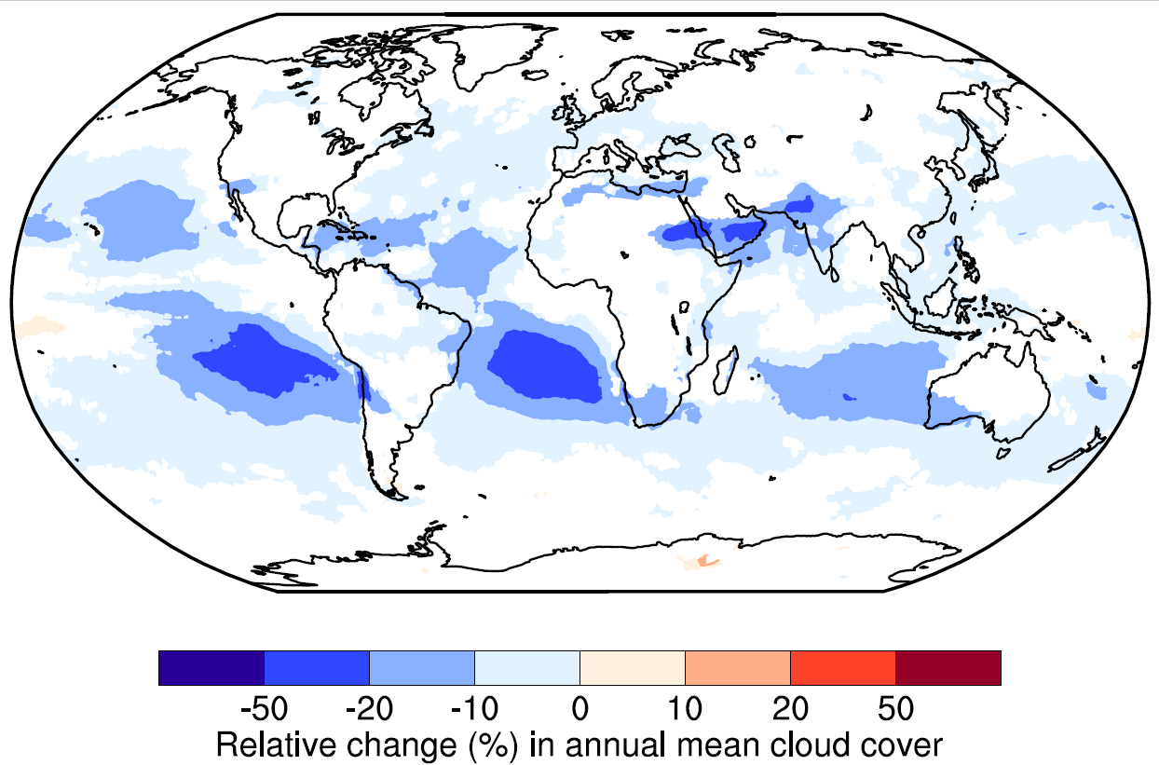
A New Experimental Strategy Identifies Sources of Undesirable Model Sensitivities
Objective
Quantify the numerical errors associated with temporal resolution in the Energy Exascale Earth System Model atmosphere model version 1 (EAMv1).
Identify the model components responsible for introducing these undesirable sensitivities to temporal resolution.
Approach
Separately vary the temporal resolution of selected model components in a series of numerical experiments.
Compare the long-term statistics of the simulated cloud properties and their impact on the amount of solar and Earth-based radiative energy that crosses the top of the atmosphere.
Impact
Developed a new experimental strategy that can be applied to systematically attribute temporal resolution error in all weather and climate models.
Error attribution is a first step towards the reductions in numerical errors necessary for making more accurate weather and climate projections.
A factor of 6 increase in temporal resolution leads to significant decreases in how frequently clouds occur in EAMv1. The figure shows relative changes in the annual mean cloud cover (unit: %). The study designed a series of numerical experiments and identified the model components responsible for the numerical errors that cause the decreases.
Wan, H., et al., “Quantifying and attributing time step sensitivities in present-day climate simulations conducted with EAMv1.” Geoscientific Model Development, 14, 1921, (2021). [DOI: 10.5194/gmd-14-1921-2021]

