Slide 1
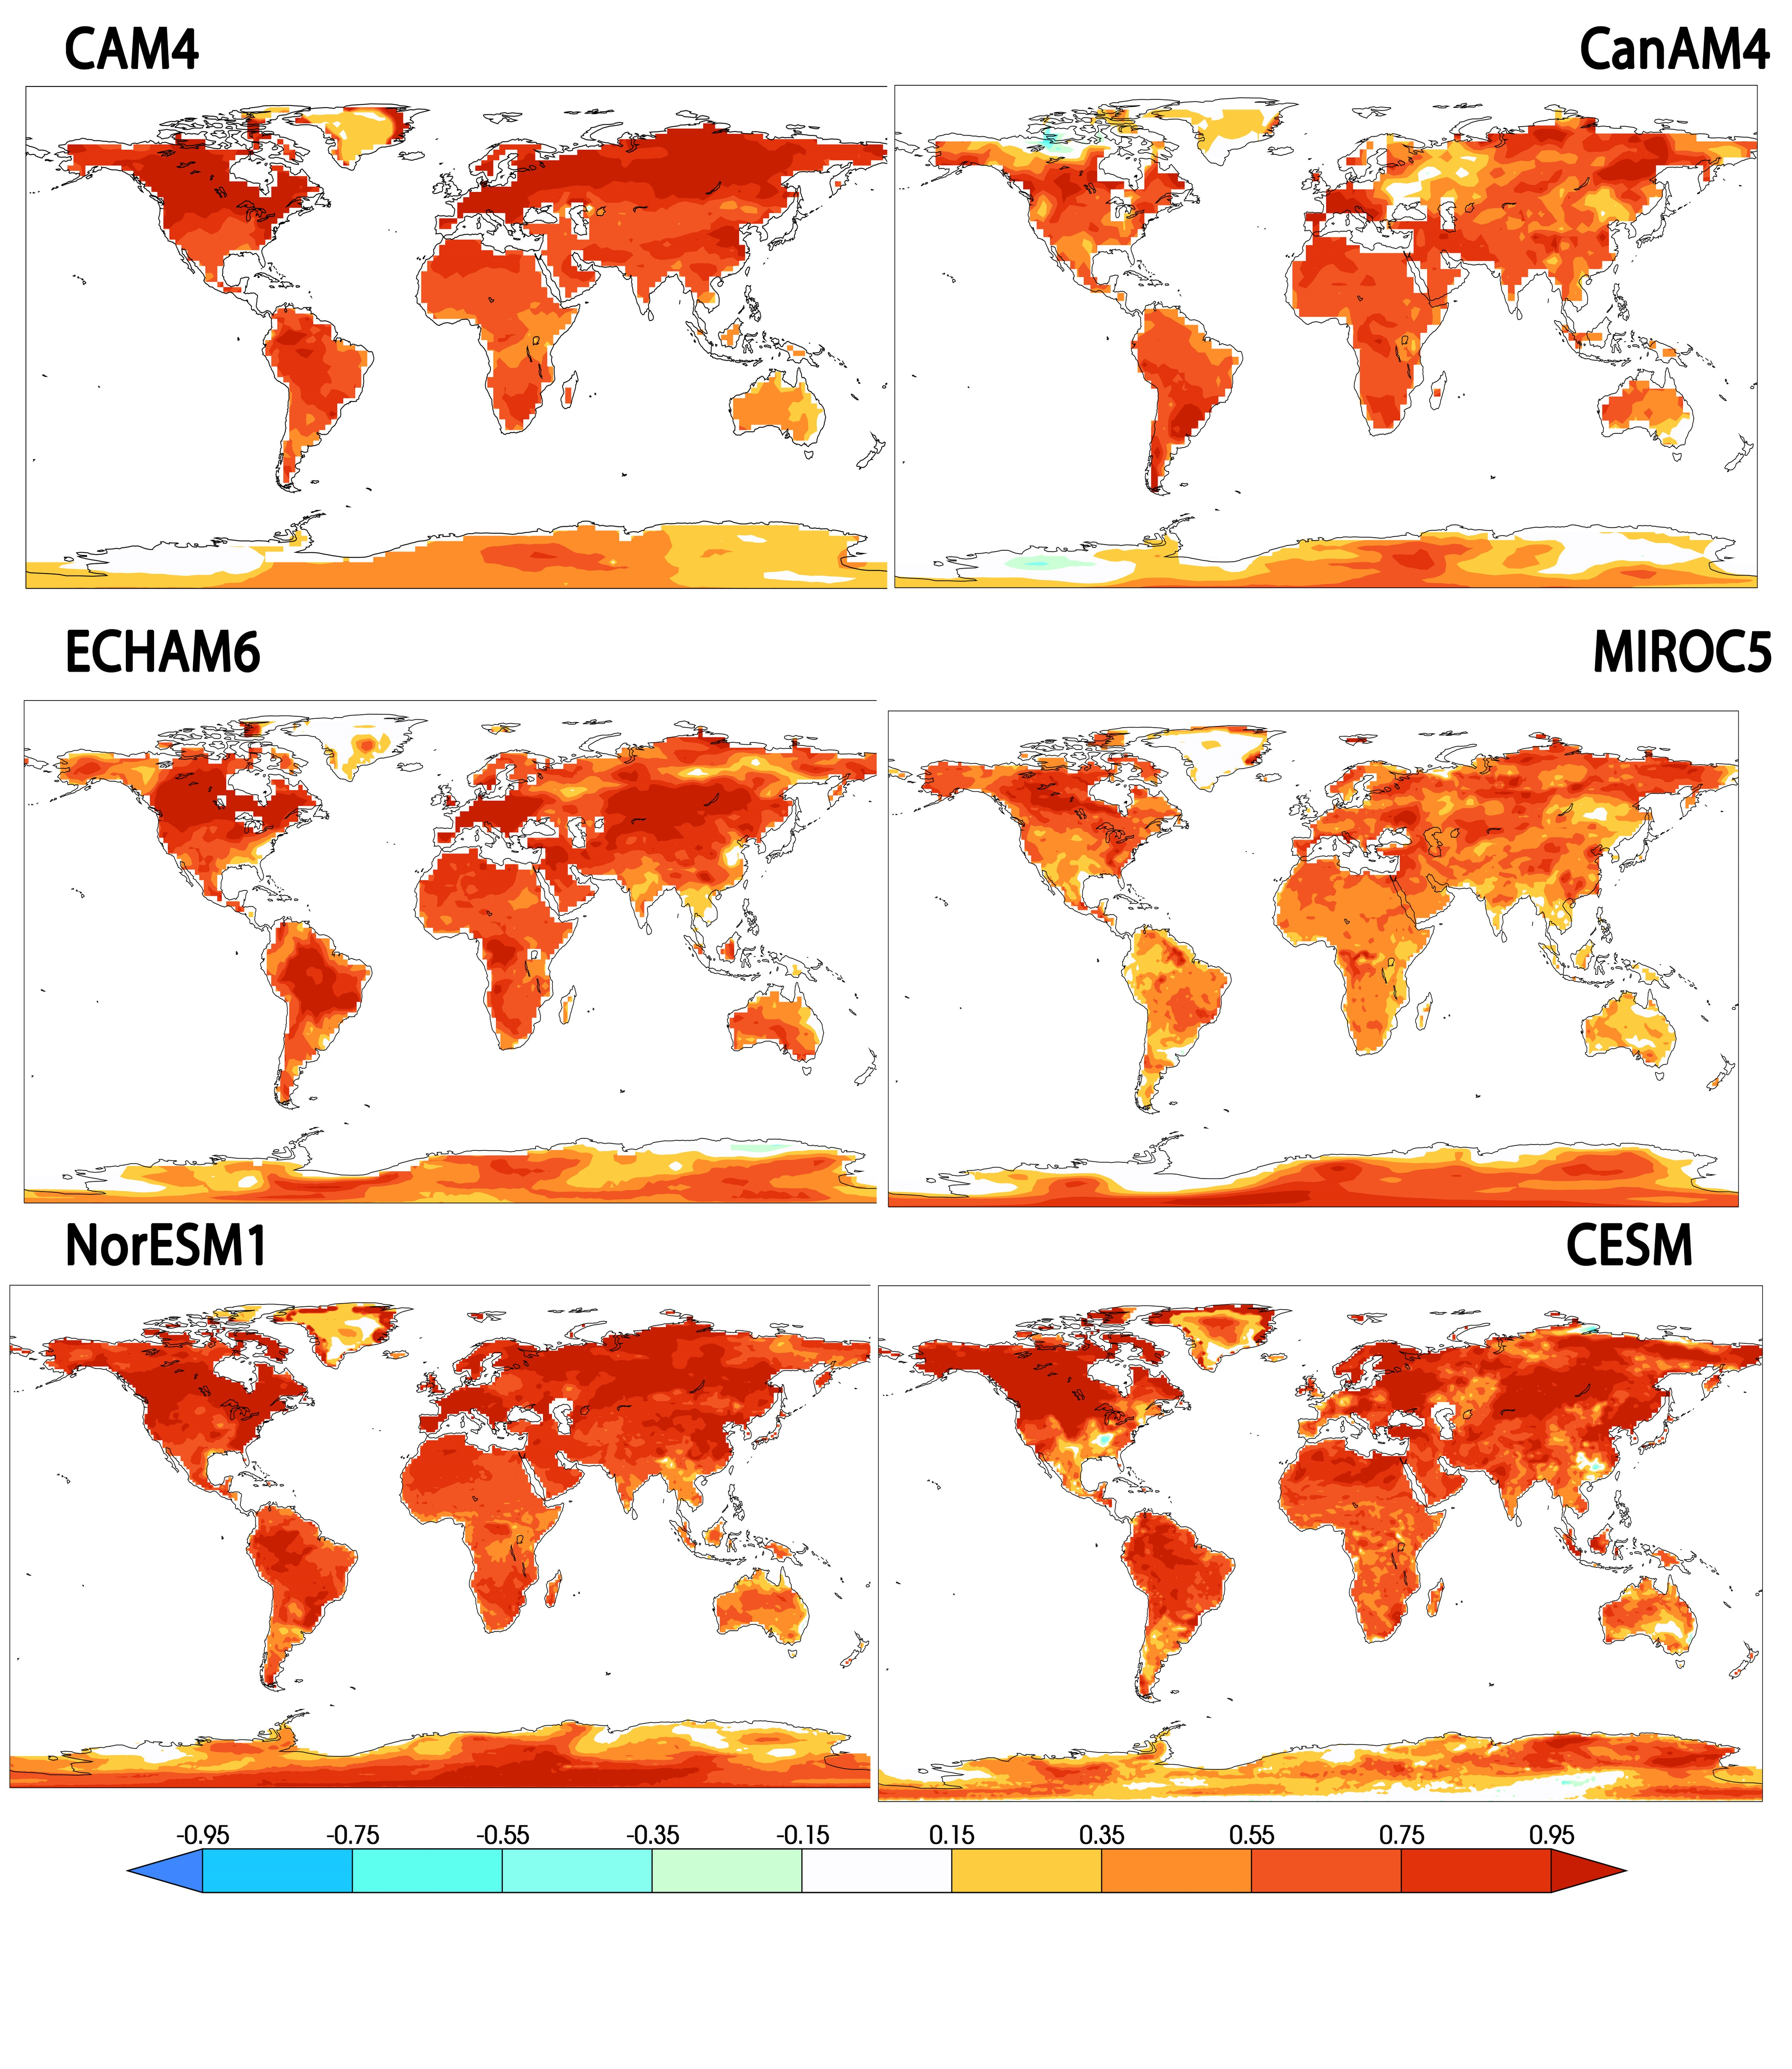
Changes in extremely hot days under stabilized 1.5ºC and 2.0ºC scenarios
We present a projection of future extremely hot days for both 1.5ºC and 2.0ºC stabilized warming scenarios using six different global climate models by examining extremes of high temperatures averaged over three consecutive days. We find that over land this measure of extreme high temperature increases from about 0.5—1.5ºC over present day values in the 1.5ºC stabilization scenario depending on location and model. We further find an additional 0.25—1.0ºC increase in extreme high temperatures over land in the 2.0ºC stabilization scenario. While model structural uncertainty is larger than uncertainties due to natural variability and statistical fitting details, it is significantly smaller than the projected changes themselves.
The United Nations Framework Convention on Climate Change (UNFCCC) invited the scientific community to explore the impacts of a world where anthropogenic global warming is stabilized at only 1.5ºC above preindustrial average temperatures. This work is cited in the special report of the intergovernmental Panel on Climate Change.
Differences in 20 year return values (ºC) between the 2.0ºC and 1.5ºC HAPPI simulations of TX3x. Upper left: CAM4. Upper right: CanAM4. Middle left: ECHAM6. Middle right: MIROC5. Lower left: NorESM1. Lower right: CESM
Michael Wehner, Dáithí Stone, Dann Mitchell, Hideo Shiogama, Erich Fischer, Lise S. Graff, Viatcheslav V. Kharin, Benjamin Sanderson, Harinarayan Krishnan (2018) Changes in extremely hot days under stabilized 1.5ºC and 2.0ºC global warming scenarios as simulated by the HAPPI multi-model ensemble. Earth System Dynamics. https://www.earth-syst-dynam-discuss.net/esd-2017-89/
We analyzed daily maximum temperature output from six global climate models
Data are available at doi.org/10.25342/HAPPI_HEATWAVE_2018

