Slide 1
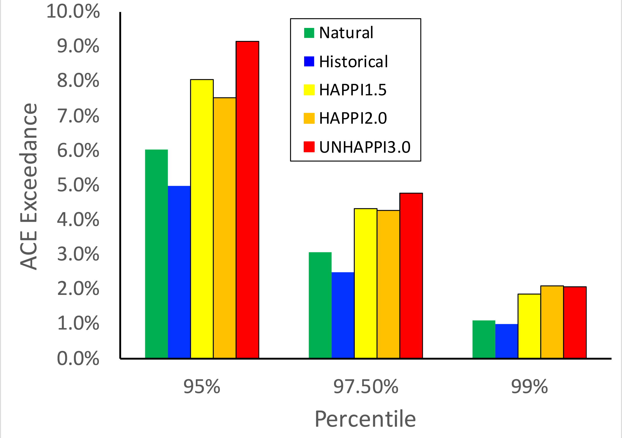
Simulated Changes in Tropical Cyclone Size, Accumulated Cyclone Energy and Power Dissipation Index in a Warmer Climate
Detection, attribution and projection of changes in tropical cyclone intensity statistics are made difficult from the potentially decreasing overall storm frequency combined with increases in the peak winds of the most intense storms as the climate warms. Multi-decadal simulations of stabilized climate scenarios from a high-resolution tropical cyclone permitting atmospheric general circulation model are used to examine simulated global changes from warmer temperatures, if any, in estimates of tropical cyclone size, accumulated cyclonic energy and power dissipation index. Changes in these metrics are found to be complicated functions of storm categorization and global averages of them are unlikely to easily reveal the impact of climate change on future tropical cyclone intensity statistics.
Storm total ACE exceedance at global warming levels of 1.5, 2 and 3C over 95, 97.5 and 99th thresholds from the Historical CAM5.1 simulation.
While importance has been ascribed to observed increases in hurricane accumulated cyclonic energy (ACE) in Atlantic Ocean, this work suggests that such changes are not necessarily to be expected at the global scale. While ACE and power dissipation index (PDI) of the strongest tropical cyclones are expected to increase, the possibility of decreases in overall tropical storm frequency counteracts resulting in little change in either global metric as simulated by the high resolution CAM5.
I conclude that global average ACE and PDI are unsuitable climate change detection and attribution metrics and that focus should be directed to changes in their extremes.
Citation: Wehner, Michael. 2021. "Simulated Changes in Tropical Cyclone Size, Accumulated Cyclone Energy and Power Dissipation Index in a Warmer Climate" Oceans 2, no. 4: 688-699. https://doi.org/10.3390/oceans2040039

