Slide 1
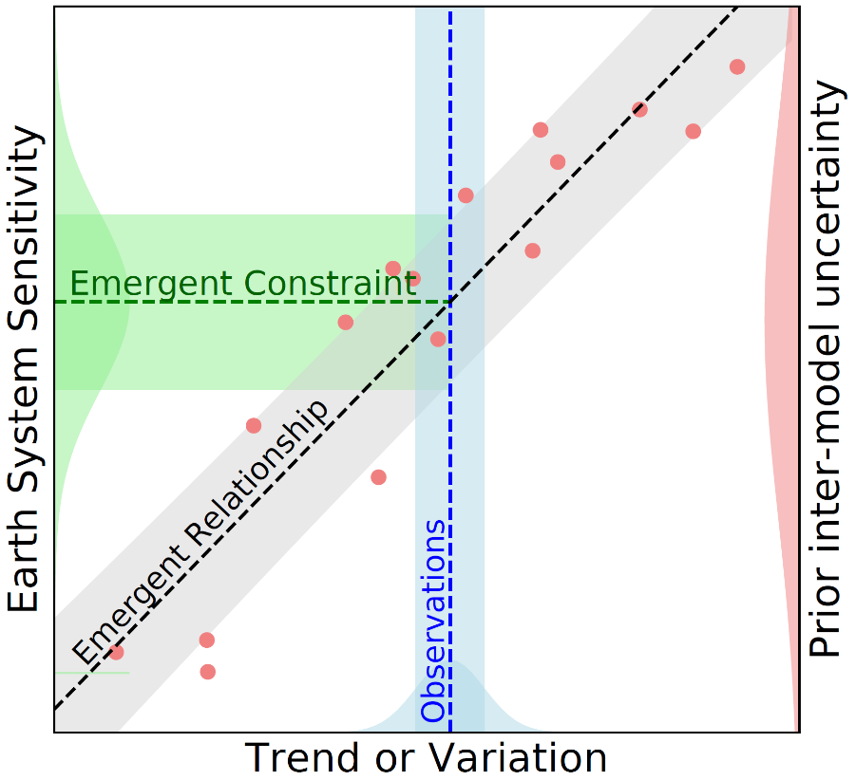
Emergent constraints on climate sensitivities
Scientific Achievement UCLA scientists in collaboration with colleagues at the University of Exeter and the UK Centre for Ecology and Hydrology synthesized the current state of knowledge surrounding the popular climate model evaluation technique known as emergent constraints. They discuss the huge promise and potential dangers of the approach and argue that emergent constraints should be based on well-founded physical principles. Significance & Impact
An important aspect of this manuscript is our attempt to convey the emergent constraint methodology to an audience outside of the geosciences by publishing in Reviews of Modern Physics. Given the rapid uptick in emergent constraint development in recent years, this paper will also serve as an important reference to climate scientists for best practices to follow.
Schematic showing the most common procedure used to derive emergent constraints on Earth system sensitivities. An ensemble of ESMs (red dots) running the same experiment (the PDF on the right-hand y axis represents the spread in the ensemble) is used to identify an emergent relationship (black dashed line) between an uncertain Earth system sensitivity Y (y axis) and an observed trend or variation X (x axis). An observation of the trend or variation (blue PDF on the x axis) can then be combined with the model-based emergent relationship to derive an emergent constraint on the Earth system sensitivity (green PDF on the left-hand y axis).
.
Research Details The team summarizes emergent constraints found in the Earth system to date and highlights key gaps in existing research. They also examine the underlying theory and statistical underpinnings of the method, and how emergent constraints link to other fields.
Williamson, M. S., C. W. Thackeray, P. M. Cox, A. Hall, C. Huntingford, and F. J. M. M. Nijsse, 2021: Emergent constraints on climate sensitivities, Rev. Mod. Phys., doi:10.1103/RevModPhys.93.025004.

