Slide 1
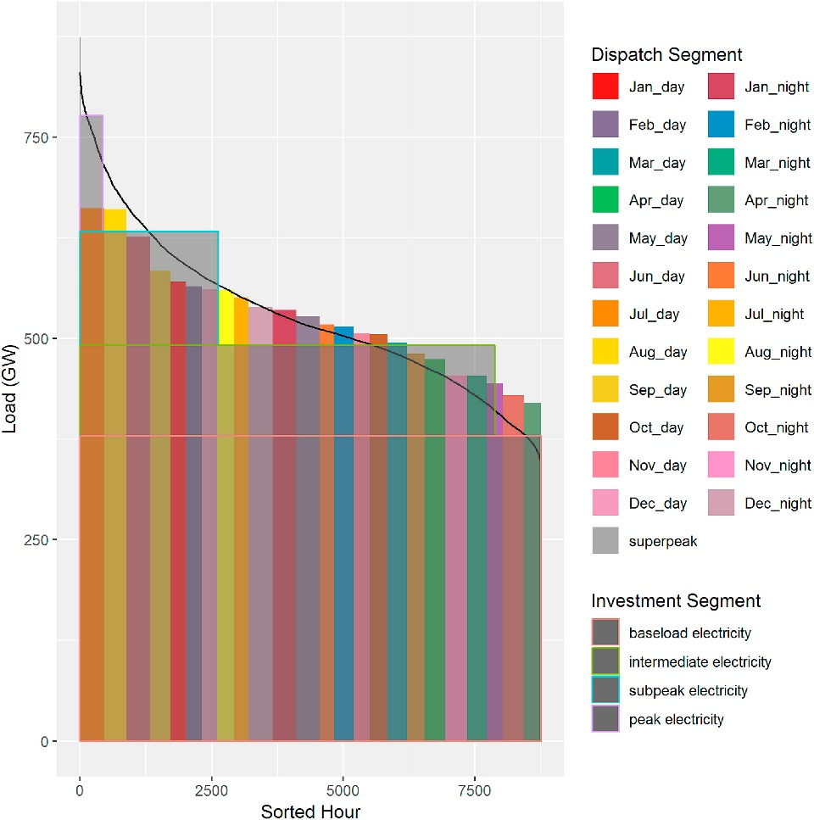
Representing Sub-annual Power Sector Dynamics and Operational Flexibility in GCAM-USA
Objective
Capture sub-annual electric power sector detail and operational flexibility along with long-term investment and multi-sector dynamics in the GCAM-USA model.
Approach
Combine linearly optimal dispatch modeling for electricity generation with a non-linear method for new capacity investment assuming imperfect foresight.
Incorporate this detailed power sector as part of the energy system in each of the 50 states in GCAM-USA.
Explore this capability by modeling the impact of different natural gas price paths on state-level power-sector investment and operation in the U.S.
Impact
Integrated least-cost dispatch modeling of electric power in a long-term, multi-sector, global model of human activity.
By assuming imperfect foresight in investment, explored future surprises such as price shocks or demand variability on sub-annual power system operation.
US Total Investment and dispatch segments. We incorporate region-specific load duration curves in each of the fifteen grid regions in GCAM-USA. For each region, we model 24 dispatch segments corresponding to day and night in each month of the year, and a “super-peak” segment, resulting in a total of 25 segments in each year.
Wise M.A., P.L. Patel, Z. Khan, S.H. Kim, M.I. Hejazi, and G.C. Iyer. 2019. " Representing Power Sector Detail and Flexibility in a Multi-sector Model " Energy Strategy Reviews. https://doi.org/10.1016/j.esr.2019.100411

