Slide 1
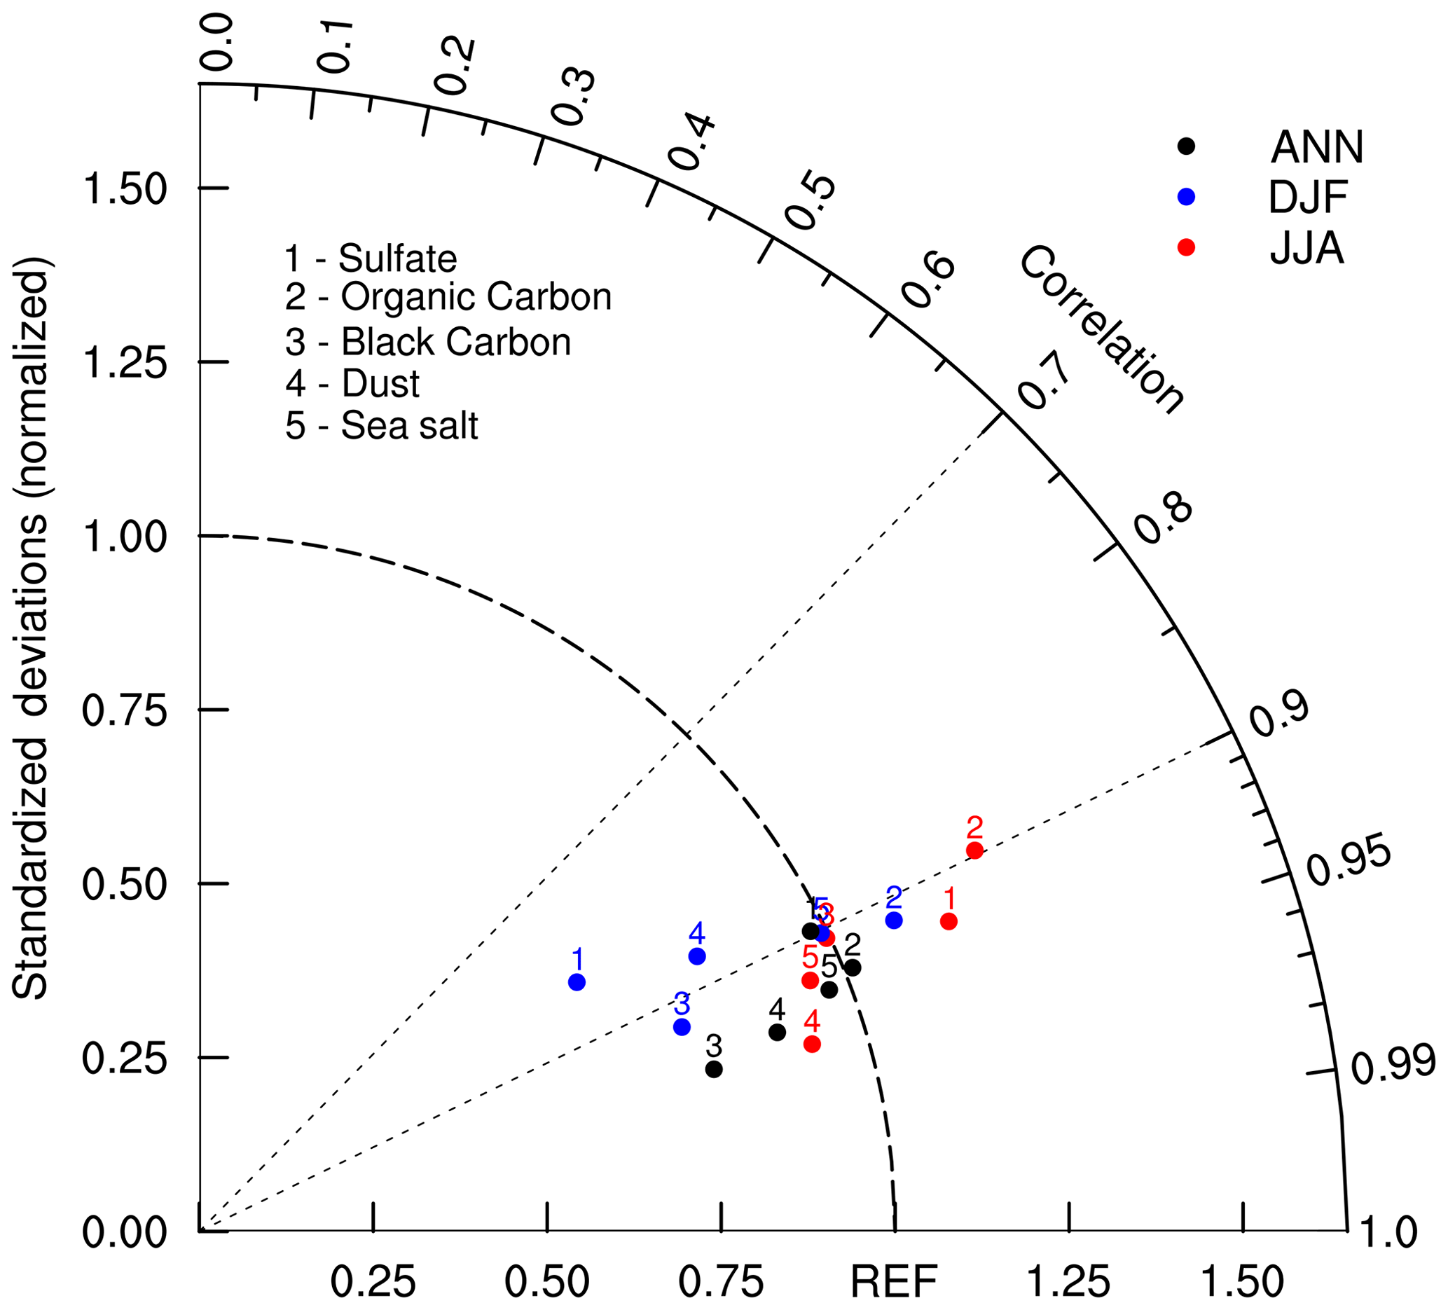
Beijing Climate Center Earth System Model version (BCC-ESM1): Model Description and Evaluation of Aerosol Simulation
Objective: The Beijing Climate Center Earth System Model version 1 (BCC-ESM1) is the first version of a fully coupled Earth system model with interactive atmospheric chemistry and aerosols developed by the Beijing Climate Center, China Meteorological Administration. Major aerosol species (including sulfate, organic carbon, black carbon, dust, and sea salt) and greenhouse gases are interactively simulated with a whole panoply of processes controlling emission, transport, gas-phase chemical reactions, secondary aerosol formation, gravitational settling, dry deposition, and wet scavenging by clouds and precipitation. Effects of aerosols on radiation, cloud, and precipitation are fully treated.
Approach: The model used here is the BCC-ESM1 with T42 horizontal resolution for the Atmosphere and land, but 1 degree for the ocean and sea ice with enhanced meridional resolution at equatorial tropics.
Results/Impacts: This paper presents a primary evaluation of aerosols simulated in version 1 of the BCC-ESM1 with the implementation of the interactive atmospheric chemistry and aerosol based on the newly developed BCC-CSM2. Global aerosols (including sulfate, organic carbon, black carbon, dust, and sea salt) and major greenhouse gases (e.g., O₃, CH₄, N₂O) in the atmosphere can be interactively simulated when anthropogenic emissions are provided to the model. Concentrations of all aerosols in BCC-ESM1 are determined by the processes of advective transport, emission, gas-phase chemical reactions, dry deposition, gravitational settling, and wet scavenging by clouds and precipitation. The nucleation and coagulation of aerosols are ignored in the present version of BCC-ESM1. Effects of aerosols on radiation, cloud, and precipitation are fully included.
Figure 1. Taylor diagram for the global aerosol climatology (1971–2000) of sulfate, organic carbon, black carbon, dust, and sea salt averaged for December–January–February (DJF) and June–July–August (JJA) and annually. The radial coordinate shows the standard deviation in the spatial pattern, normalized by the observed standard deviation. The azimuthal variable shows the correlation of the modeled spatial pattern with the observed spatial pattern. Analysis is for the whole globe. The reference dataset is the CMIP5 prescribed dataset.
Wu,T., F. Zhang, J. Zhang, W. Jie, Y. Zhang, F. Wu, L. Li, J. Yan, X. Liu, X Lu, H. Tan, L. Zhang, J. Wang, and A. Hu, 2020, Beijing Climate Center Earth System Model version (BCC-ESM1): Model Description and Evaluation of Aerosol Simulation, Geoscientific Model Development, 13, 977-1005, doi:10.5194/gmd-13-977-2020.

