Slide 1
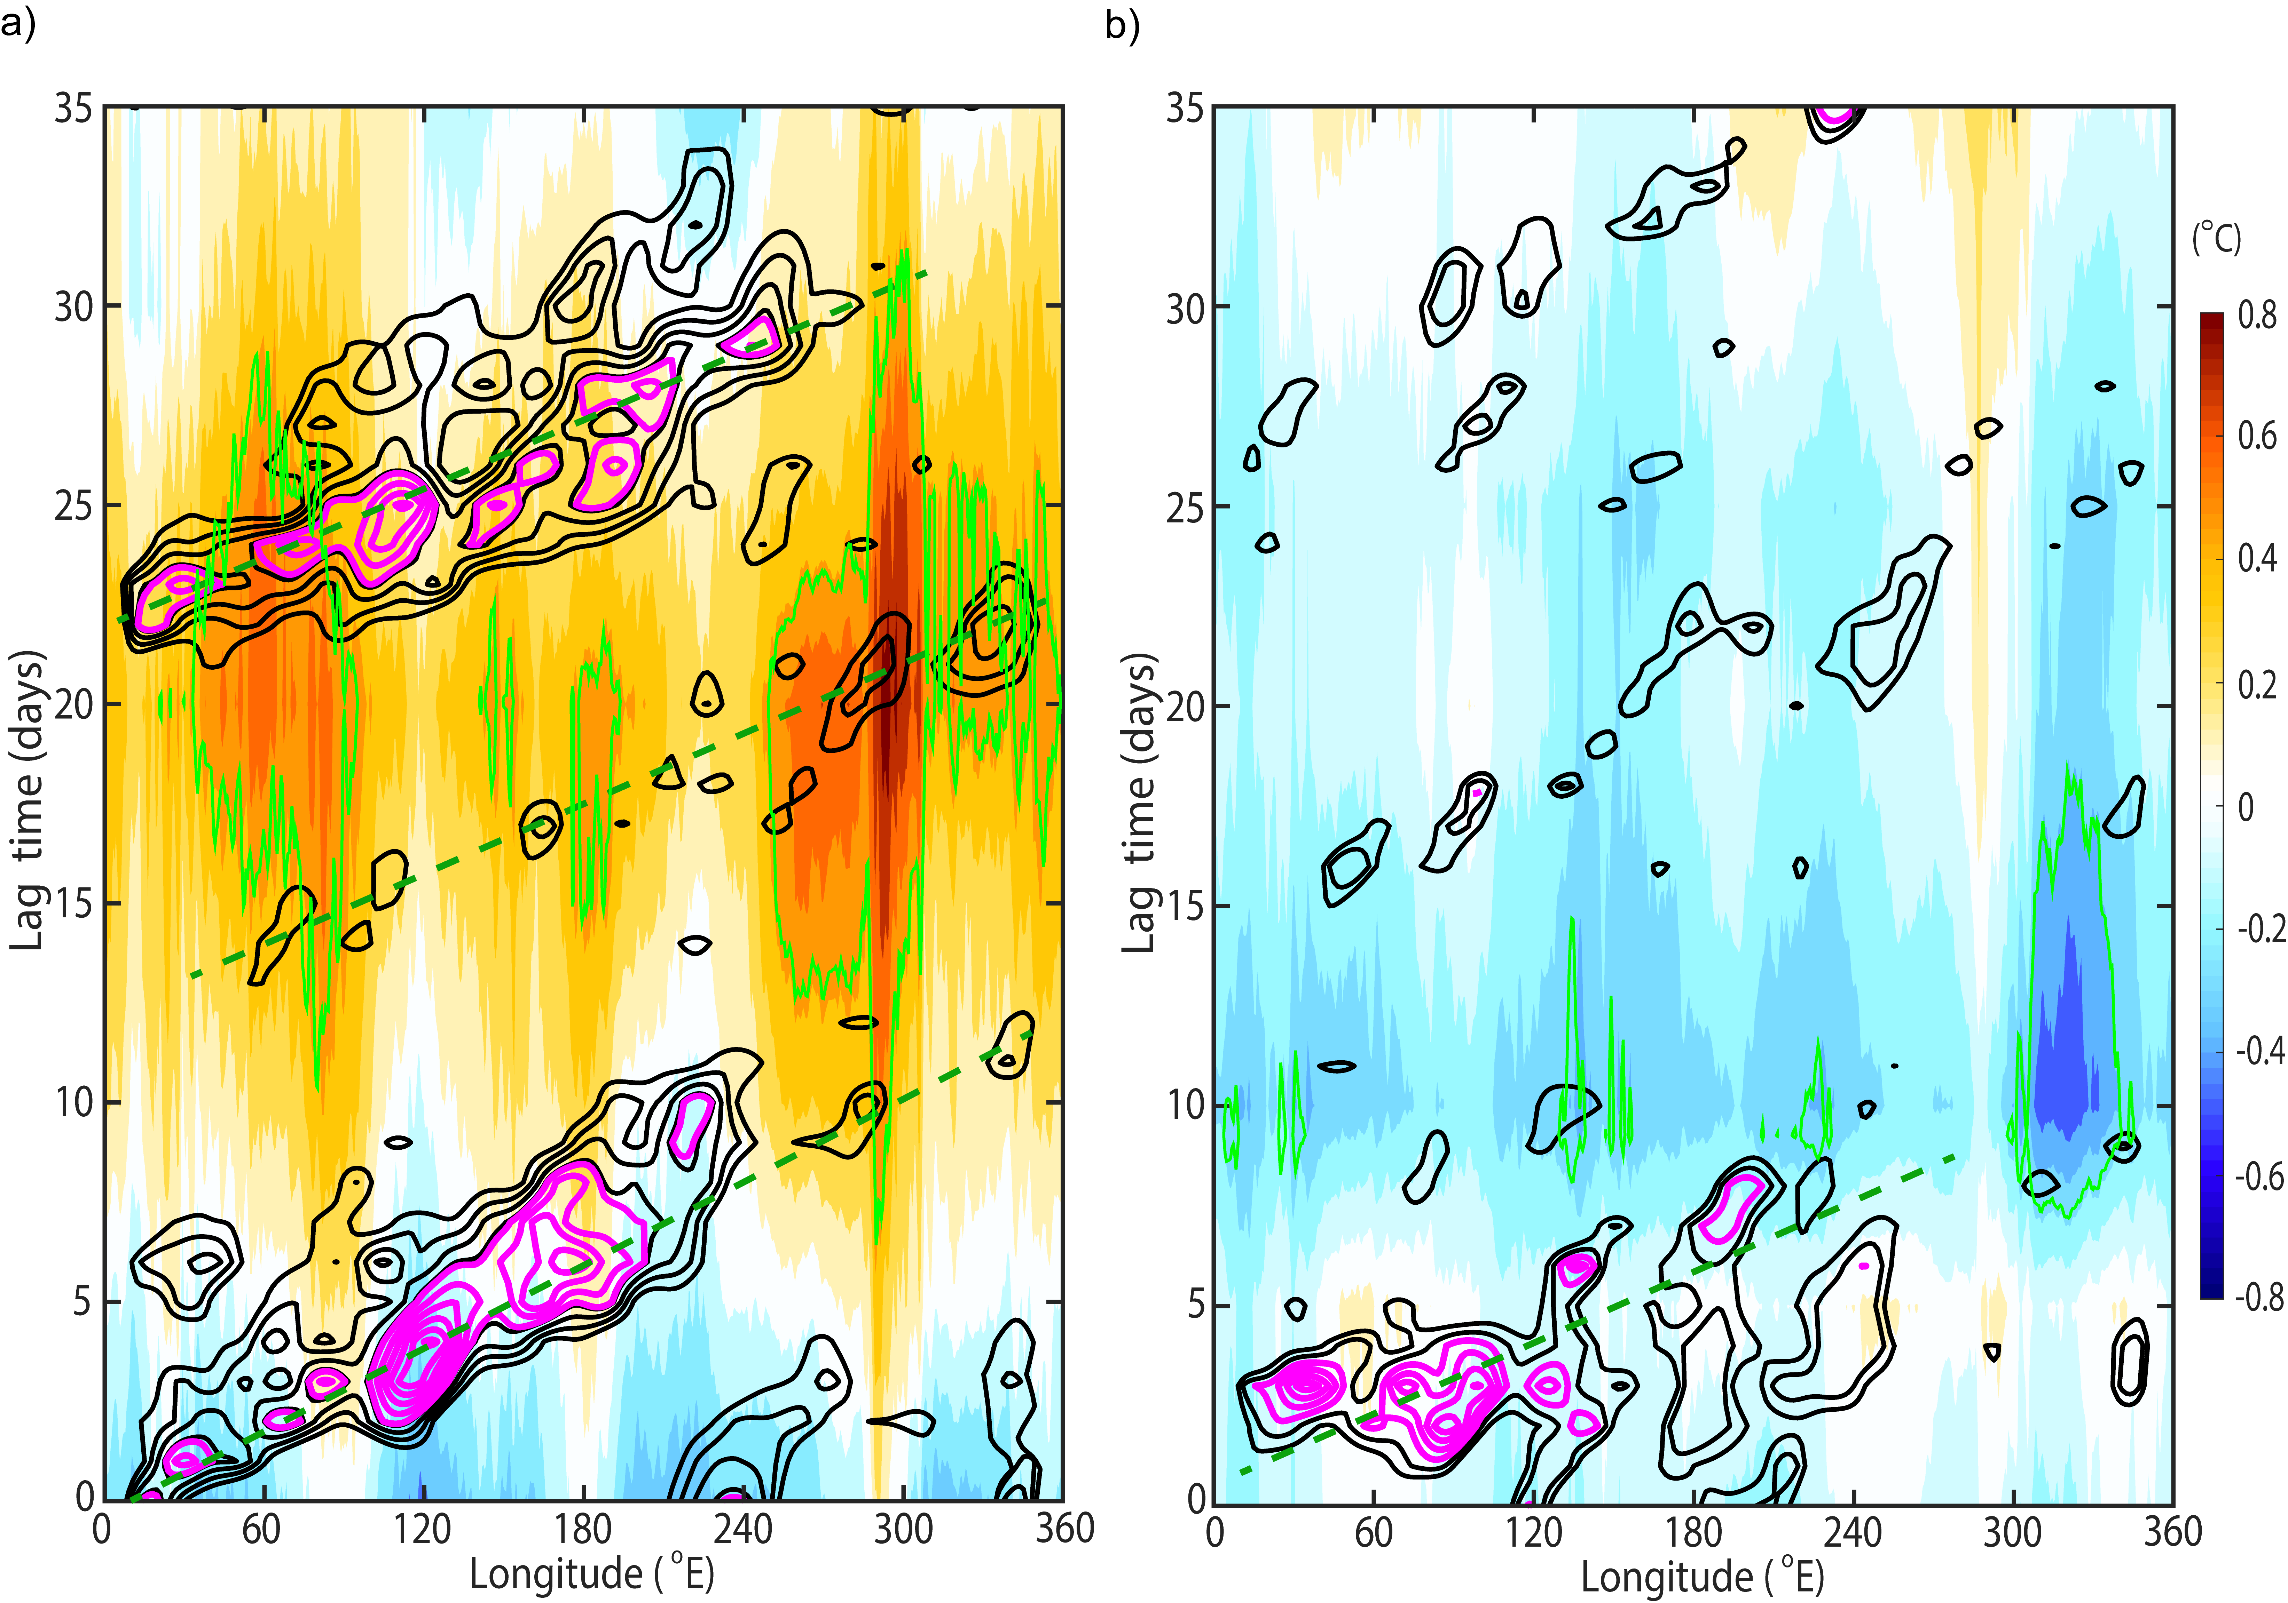
Coupling Between Oceanic and Atmospheric Oscillations Produces Southern Hemisphere Predictability
Objective
Detect oceanic interference as a cause of observed 25-day periodicity in the dominant mode of Southern Hemisphere midlatitude eddy activity.
Approach
Use wave packet extraction over a fixed longitudinal domain to isolate the envelope of the midlatitude eddies.
Perform spectral and composite analysis on multiple observation and reanalysis data sets from several sources to identify prominent spectral peaks in both ocean and atmosphere.
Impact
Detected a significant 25-day periodicity in the regional representation of the baroclinic annular mode (BAM), the leading mode of variability of the studied storm track eddy activity.
Discovered a ~100-day oscillation in Southern Ocean sea surface temperature and its selective interference with BAM.
The downstream effect of the regional BAM periodicity could lead to increased predictability of precipitation over northeast Australia and Patagonia at an intraseasonal scale.
A composite Hovmöller plot of wave packets (measuring wave amplitude) based on the largest wave activity events in the analysis domain (40º-55ºS, 80º-210ºE) modeled with (left panel) and without (right panel) a reoccurrence 25 days later. The contrast between the two panels reveals the constructive interference with the periodic behavior of the BAM wave activity from oceanic sea surface temperature warming.
D. Xue, J. Lu, Y. Qian, & Y. Zhang, ”Evidence for Coupling Between the Subseasonal Oscillations in the Southern Hemisphere Midlatitude Ocean and Atmosphere.” Journal of Geophysical Research, 126, (2021). https://doi.org/10.1029/2020JD033872
Notes:
http://www.pnnl.gov/science/highlights/highlights.asp?division=749

