Slide 1
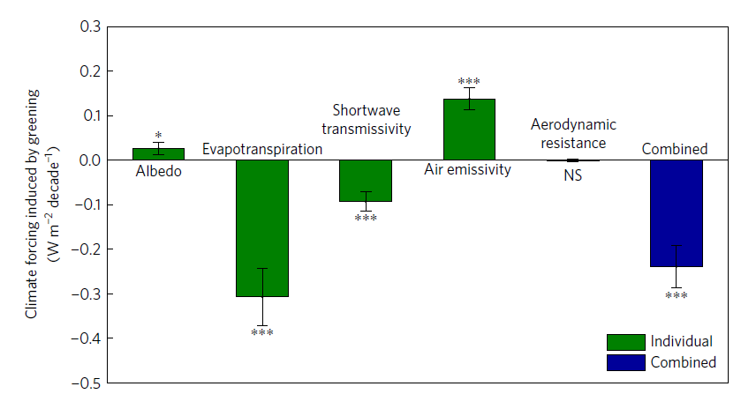
Climate mitigation from vegetation biophysical feedbacks during the past three decades
Expanded vegetation growth mitigates recent climate warming through increased evapotranspiration
Objective | Quantify the response of near-surface air temperature to the slow but persistent increase in vegetation leaf area index (LAI) that has been observed over recent decades.
New science | Remote sensing observations of vegetation greenness are combined with near-surface air temperature observations over land and ocean and coupled climate system simulations (including new simulations with the ACME model) to describe the influence of changing LAI on global-scale air temperatures. Greening of Earth causes a reduction in near-surface air temperature through increased evapotranspiration and decreased shortwave transmissivity.
Significance | Our study quantifies an Earth system feedback which benefits society by mitigating some of the temperature increase associated with anthropogenic climate change.
Zeng., Z., S. Piao, L. Z. X. Li, L. Zhou, P. Ciais, T. Wang, Y. Li, X. Lian, E. F. Wood, P. Friedlingstein, J. Mao, L. D. Estes, R. B. Myneni, S. Peng, X. Shi, S. I. Seneviratne and Y. Wang, 2017. Nature Climate Change, DOI: 10.1038/nclimate3299
Changing evapotranspiration is the most important factor driving a reduction in air temperature associated with recent greening of the land biosphere.
Contact: Xiaoying Shi, 865-241-9199, shix@ornl.gov
Notes:
Impact Factor: 19.304
PI: Xiaoying Shi (for ORNL work)
PM: Dorothy Koch (Earth System Modeling, BER)
Notes:
Several coupled Earth system models, including DOE’s ACME v0, were used to perform simulations of coupled climate system response when forced with observed global space and time variation of leaf area index, for the historical period 1982-2011. While near-surface air temperatures have been observed to rise over this period, our modeling suggests that increases in vegetation greenness (quantified as leaf area index, or LAI) tended to suppress the increase in temperature. This overall suppression of temperature rise is a net effect from negative feedbacks associated with increased evapotranspiration and reduced shortwave transmissivity, partly offset by positive feedbacks associated with increased thermal emissivity of the atmosphere and reduced land surface albedos.
The overall effect of increased LAI on temperature is estimated as a 0.09 (+/- 0.02) °C suppression of global-scale warming over land for the period 1982-2011, or a mitigation of about 12% of the observed warming over land for the past 30 years.

