Slide 1
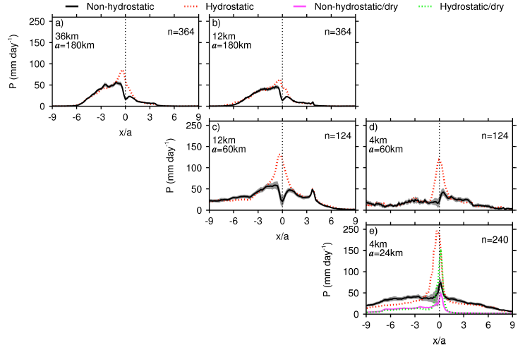
Exploring the Effects of a Nonhydrostatic Dynamical Core in High-Resolution Aquaplanet Simulations
Objective
Explore the effects of a nonhydrostatic (accounting for water movement) dynamical core in high-resolution climate simulations in an idealized aquaplanet (all-water world)
Approach
Perform regional forecasting model (WRF) simulations with a hydrostatic (water at rest) and a nonhydrostatic dynamical core in an aquaplanet with and without a idealized land mountain
Perform simulations at resolutions of 4 km, 12 km, and 36 km to determine the differences between the hydrostatic and nonhydrostatic simulations
Analyze the simulations over the tropics and subtropics, and evaluate the differences in moist processes between the hydrostatic and nonhydrostatic simulations
Comparison of precipitation simulated with hydrostatic (H) and nonhydrostatic (NH)
dynamical cores and with and without moist processes over a mountain in the tropics. Large differences are found between the H and NH simulations and with and without moist processes, showing that such processes intensify H and NH differences.
Impact
This study found that moist processes intensify the differences between simulations using hydrostatic and nonhydrostatic dynamical cores
The findings show a need to more systematically compare simulations with hydrostatic and nonhydrostatic dynamical cores in climate models at resolutions between 12 km and 36 km in realistic configurations
Yang Q, LR Leung, J Lu, Y-L Lin, S Hagos, K Sakaguchi, and Y Gao. 2017. “Exploring the Effects of a Nonhydrostatic Dynamical Core in High-Resolution Aquaplanet Simulations.” Journal of Geophysical Research: Atmospheres, accepted. DOI: 10.1002/2016JD025287
Notes:
http://www.pnnl.gov/science/highlights/highlights.asp?division=749

