Slide 1
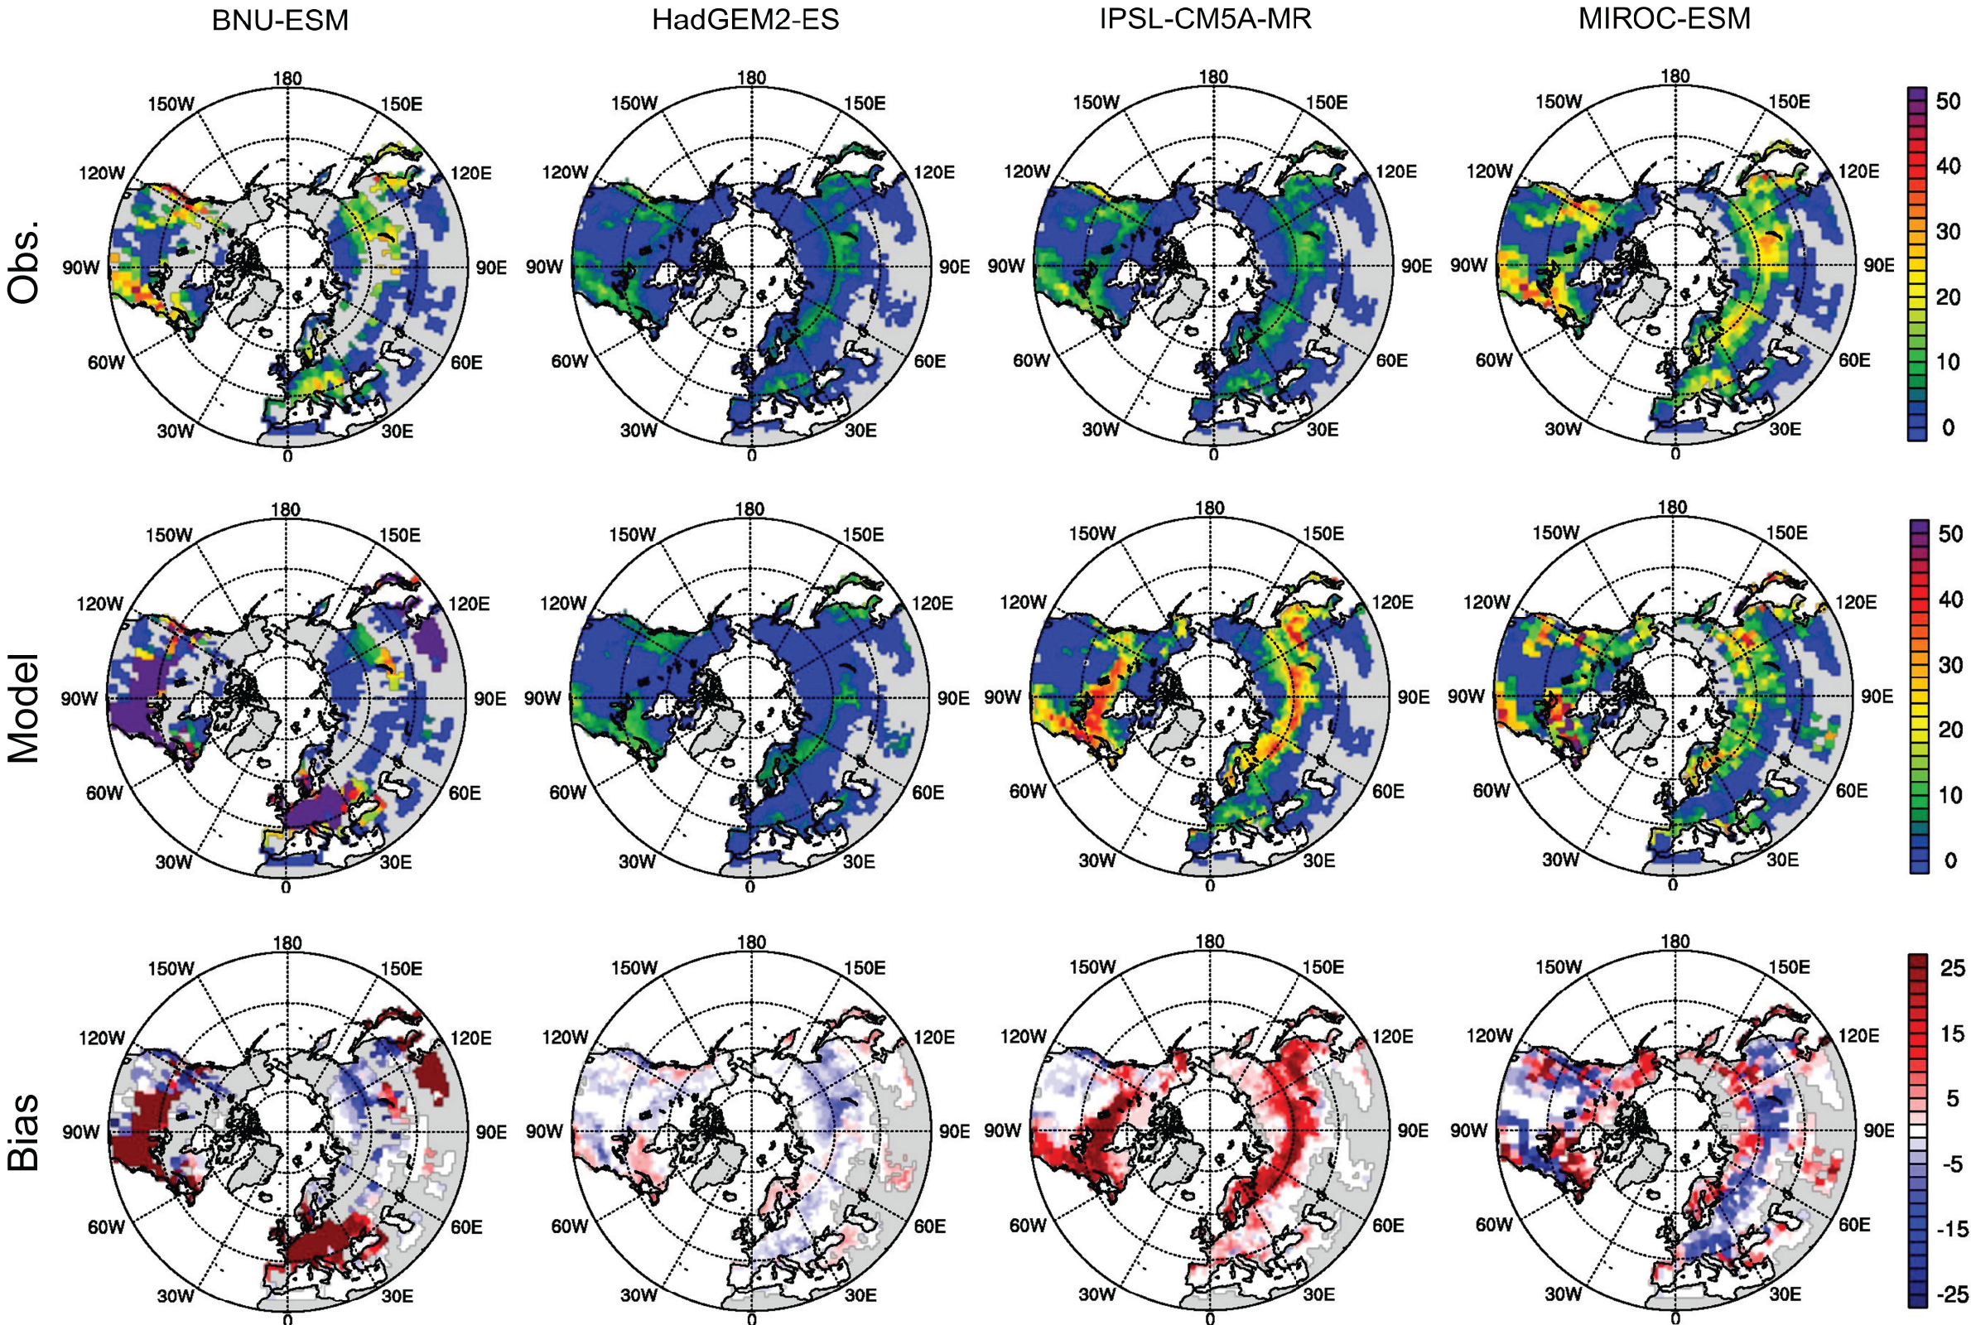
Biases in forest distributions in CMIP5 models lead to large uncertainties in extratropical forest biomass
Objective: To quantify uncertainty in the representation of forests in CMIP5 models.
Approach: We used a satellite-derived forest biomass dataset for the extratropical Northern Hemisphere to assess forest fraction, distribution, and component mass from CMIP5 models.
Results/Impacts: Models exhibited large biases in forest fraction, distribution, and mass of carbon pools (ranging from −20 Pg C to 135 Pg C) that resulted in uncertainties in forest biomass. Better constraints on carbon allocation, vegetation distribution, and initial conditions are needed.
Figure: Contemporary total forest carbon mass (10⁻² Pg C) in the northern extratropics for upscaled observations (top row), four CMIP5 models (middle row), and their differences (bottom row).
Yang, C.-E., J. Mao, F. M. Hoffman, D. M. Ricciuto, J. S. Fu, C. D. Jones, and M. Thurner (2018), Uncertainty quantification of extratropical forest biomass in CMIP5 models over the Northern Hemisphere, Sci. Rep., 8:10962, doi:10.1038/s41598-018-29227-7.

