Slide 1
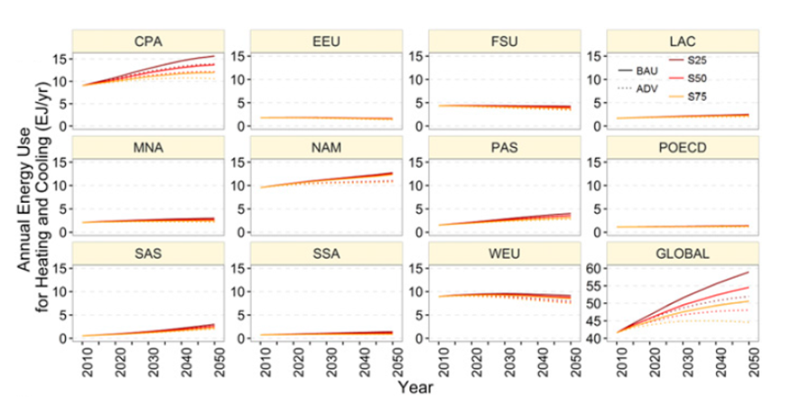
Global Scenarios of Urban Density and Its Impacts on Building Energy Use through 2050
Objective
Examine the uncertainty in the spatial dimension of urbanization and analyze the change of urban forms and their impact on building energy use at regional and global level
Approach
Use a Monte-Carlo approach to develop trajectories of urban population density and estimate future floor area as a function of urban population density and per capita gross domestic product
Develop scenarios of urbanization and energy efficiency to understand implications on energy use
Use both top-down (GCAM) and bottom-up (3CSEP HEB) models to assess building energy use for heating and cooling
Regional and global heating and cooling energy use under six scenarios with different urban forms and technology levels
Impact
The research demonstrates how innovative methods can be used to incorporate urban form into long-term scenarios.
The research demonstrated how the spatial configuration of urban areas might affect energy use and other criteria associated with quality of life.
Güneralpa B, Y Zhou, D Ürge-Vorsatz, M Gupta, S Yu, P Patel, M Fragkias, Xiaoma Li, Karen C. Seto. 2017. “Global Scenarios of Urban Density and Its Impacts on Building Energy Use through 2050.” Proceedings of the National Academy of Sciences, early edition. DOI: 10.1073/pnas.1606035114.
Notes:
http://www.pnnl.gov/science/highlights/highlights.asp?division=749

