Slide 1
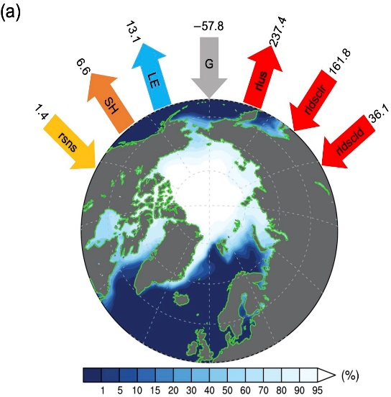
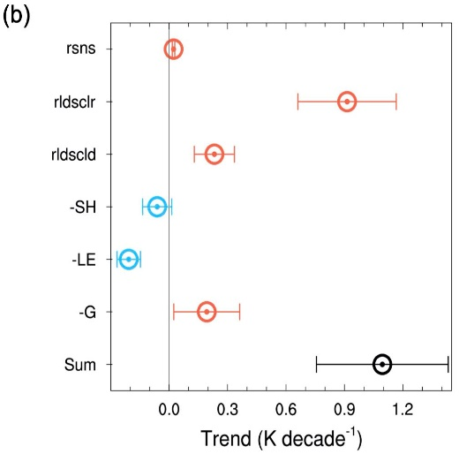
What Factors Contribute to Recent Rapid Wintertime Arctic Warming?
Objective
Quantify the contributions of various terms affecting the surface energy budget to the cold season (October–February) Arctic surface warming trend.
Describe the impact of atmospheric temperature and moisture changes on surface warming.
Approach
Analyze observationally based reanalysis data (1979−2020) to identify important factors influencing Arctic surface temperature and energy budget terms.
Use the surface radiative-kernel method to calculate the source contribution of temperature and moisture to the surface longwave energy flux.
Impact
An increase in clear-sky downward longwave radiation explains 82% of the cold season Arctic surface warming trend.
Reduced low inversion strength largely explains the reduction in the downward flux of infrared energy due to vertically nonuniform temperature and related moisture changes.
Lapse-rate feedback in the Arctic cold season is likely a consequence of sea-ice changes and the sea-ice albedo feedback during the preceding warm season.
(a) The cold season (October–February) mean sea ice concentration (shading) and surface energy budget terms (W m⁻²) over the Arctic, including net shortwave (rsns), sensible heat (SH), latent heat (LE), upward longwave (rlus), clear-sky downward longwave (rldsclr), longwave cloud forcing (rldscld), and net gain (G). (b) Contributions of different energy budget terms to the total Arctic surface warming trend (1.11 K per decade) in the cold season.
Zhang, R., Wang, H., Fu, Q., Rasch, P. J., Wu, M., and Maslowski, W. (2021). Understanding the cold season Arctic surface warming trend in recent decades. Geophysical Research Letters, 48, e2021GL094878. DOI: 10.1029/2021GL094878
Notes:
http://www.pnnl.gov/science/highlights/highlights.asp?division=749

