Slide 1
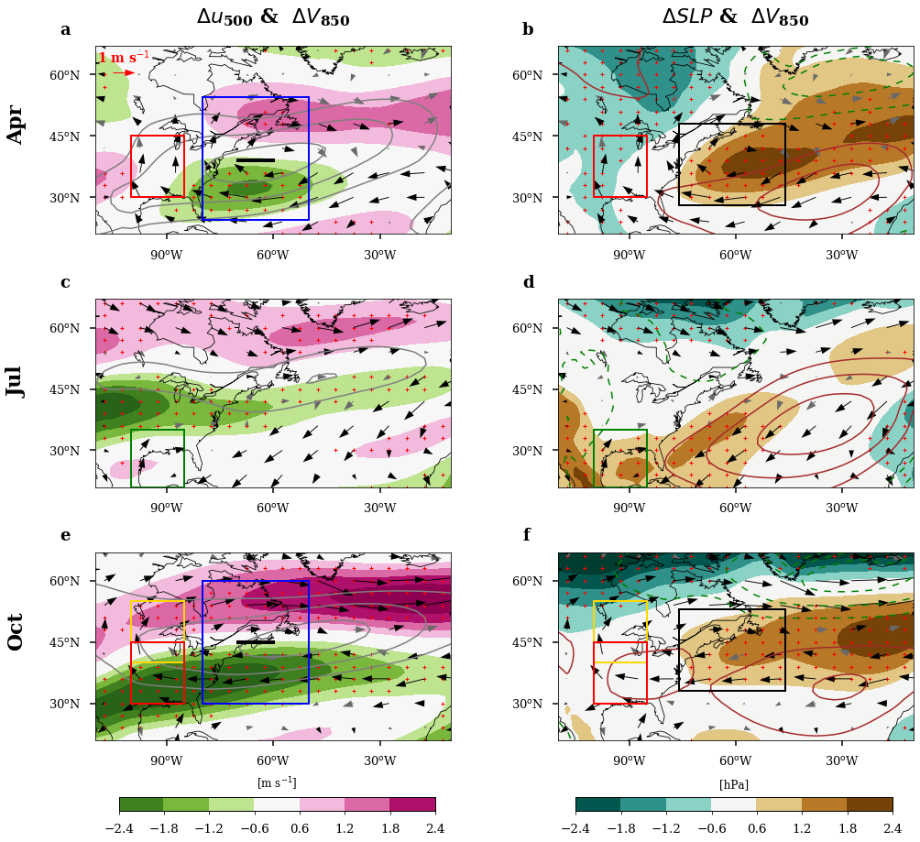
Global Warming Induces Seasonally Dependent Great Plains Low-Level Jet Changes
Objective
Present a detailed investigation of the future changes in the Great Plains low-level jet (GPLLJ) as a function of the season.
Reveal the large-scale drivers of the GPLLJ changes.
Approach
Analyze regional circulation changes under Representative Concentration Pathway 8.5 based on ensemble projections of the Coupled Model Intercomparison Project Phase 5 and 6 climate models.
Explain the seasonally dependent GPLLJ changes in the context of coupled regional circulation changes that involve the North Atlantic subtropical high (NASH) and the North America westerly jet (NAWJ).
Impact
Future warming results in an enhanced GPLLJ in spring and fall, with little change in summer. This implies distinct seasonal impacts on the Central United States hydroclimate and extreme weather events.
The established dynamical links provide guidance for constraining climate model projections of the GPLLJ and NASH changes and generating more credible projections of overall Central United States hydroclimatic changes.
In April and October, the poleward NAWJ shift drives the anomalous surface high poleward of the NASH, leading to intensification and further northward extent of the GPLLJ.
In July, the enhanced land–sea contrast dominates the westward extension of the NASH, with little change in the GPLLJ.
W. Zhou, L. R. Leung, F. Song, and J. Lu. “Future changes in the Great Plains Low-Level Jet governed by seasonally dependent pattern changes in the North Atlantic Subtropical High.” Geophysical Research Letters, 48, e2020GL090356, (2021). [DOI: 10.1029/2020GL090356.]

