Slide 1
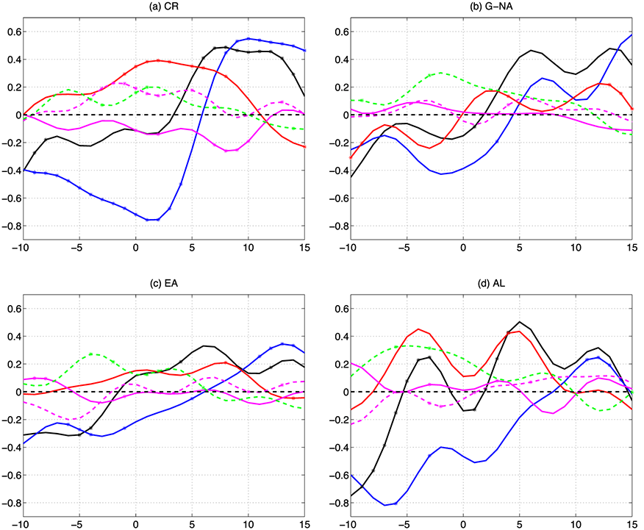
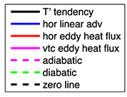
Heat Budget Analysis
of Northern Hemisphere
High-Latitude Spring Onset Events
Objective: The study aims to provide a complete quantitative understanding of the physical sources responsible for rapid near-surface air temperature increases that occur in association with regional spring onset events within the Artic atmosphere.
Research: The current work first identifies four categories of spring onset events in the following regions: the primary (critical) region over North
Siberia (CR), Greenland-North America (G-NA), East Asia (EA), and Alaska (AL). Local changes in near-surface air temperature anomalies are decomposed into distinct dynamic and thermo-dynamic parts using a heat budget analysis. The spatial and temporal structures of these dynamic and thermodynamic processes and their relative contributions to the sequential regional changes in temperature anomalies are investigated.
Composite time evolution from day -10 to day +15 of daily areal-average contributions (units: K/day) to temperature anomaly (T’) tendency due to linear temperature advection (blue), anomalous horizontal eddy heat flux convergence (red), anomalous vertical eddy heat flux convergence (pink),
and anomalous adiabatic (pink dash) and diabatic (green dash) heating for spring onset events over (a) Siberia, (b) Greenland and (c) East Asia.
Impact: Our diagnostic results demonstrate that anomalous dynamical processes associated with synoptic eddy activity and quasi-stationary wave patterns are the primary contributors to the rapid temperature increases observed to occur during Arctic spring onset, with minimal contributions coming from anomalous diabatic processes.
Reference: He, J., and R.X. Black, 2016: Heat Budget Analysis of Northern Hemisphere High-Latitude Spring Onset Events, Journal of Geophysical Research, 121, 10,113-10,137.

