Slide 1
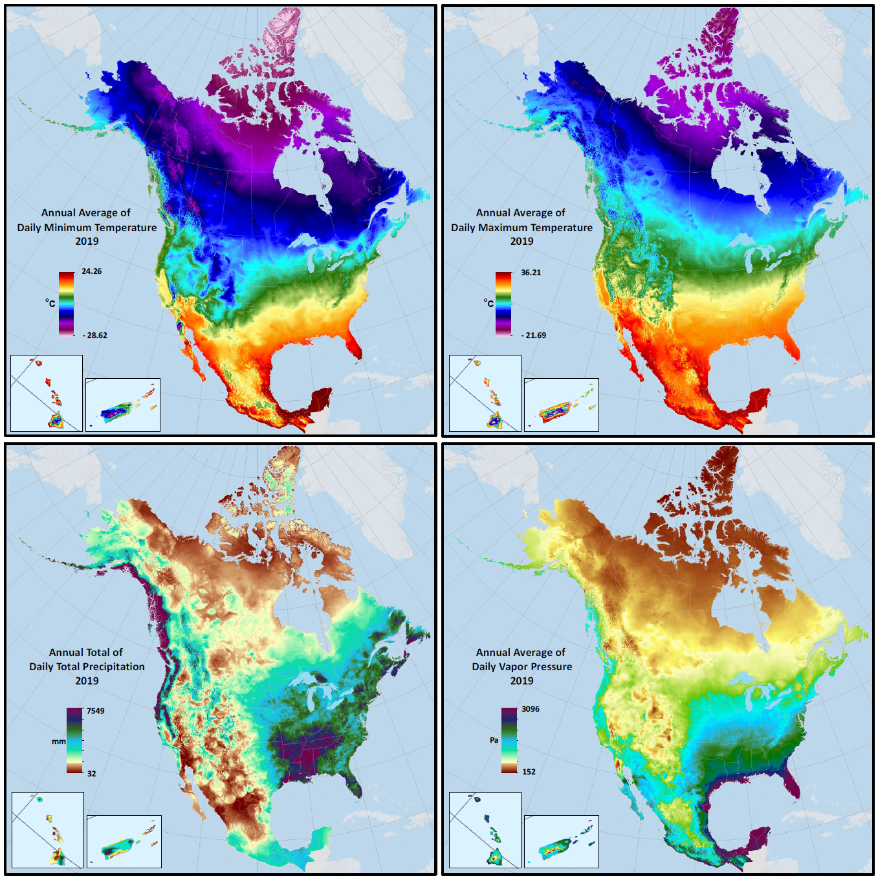
Earth and Environmental System Modeling, E3SM
High-Impact Publication: Daymet v4 - High-resolution, multi-decadal surface weather dataset for land process prediction over North America, with uncertainty quantification
Objective | Produce best-possible historical surface weather drivers at high resolution over North America, as forcing for 1km E3SM land model simulations
New science | 3-dimensional regression approach to estimate horizontal and vertical gradients from observations across a range of station density Corrected observational bias related to time-of-day for observations Corrected high-elevation temperature observation bias related to change in instrumentation
Impact | Combination of high spatial resolution, multi-decadal period of record, improved ability to capture extreme events, and comprehensive uncertainty quantification makes Daymet v4 a best-in-class methodology and data product for Earth system model applications
Thornton, P.E., R. Shrestha, M. Thornton, S.-C. Kao, Y. Wei, B.E. Wilson (2021) Gridded daily weather data for North America with comprehensive uncertainty quantification. Nature Scientific Data, DOI:: 10.1038/s41597-021-00973-0. Access the Daymet v4 dataset online at: https://daymet.ornl.gov
Daymet v4 2019 annual climatologies for maximum and minimum temperature, precipitation, and humidity.

