Slide 1
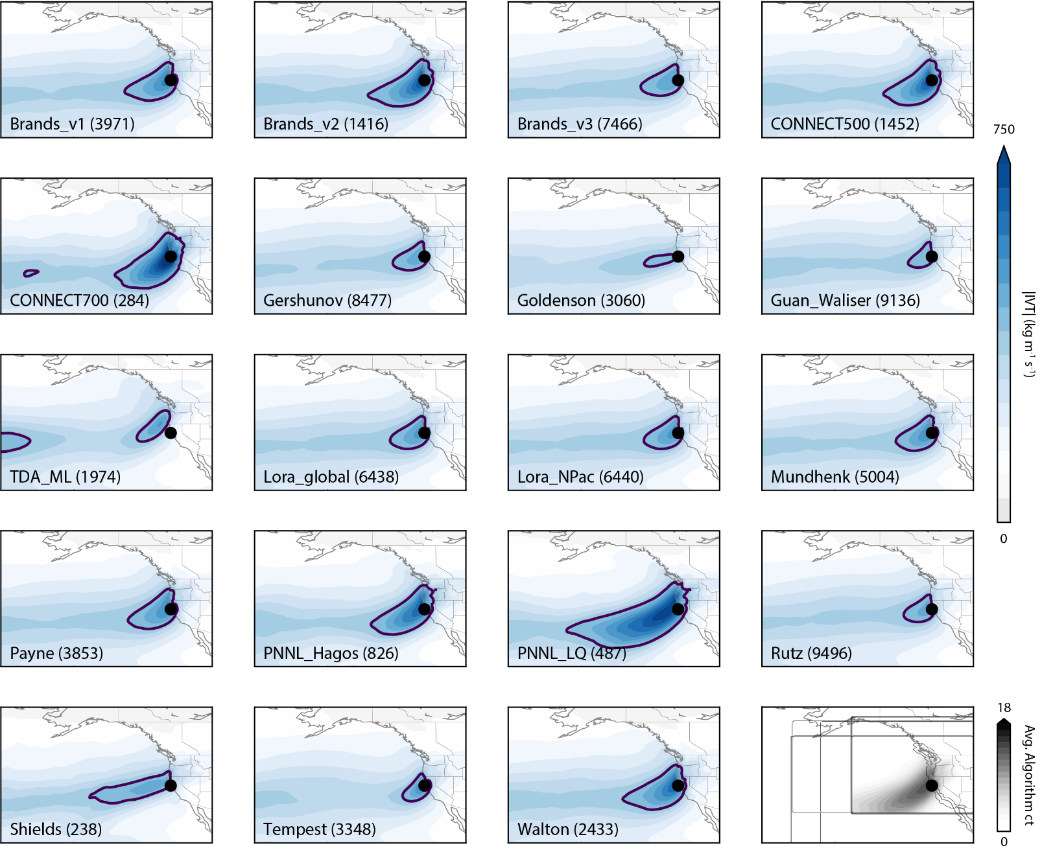
The Atmospheric River Tracking Method Intercomparison Project (ARTMIP): Quantifying Uncertainties in Atmospheric River Climatology
OBJECTIVE
Define and quantify uncertainties in atmospheric river climatology based on detection/tracking algorithm.
APPROACH
20+ different AR identification and tracking methods applied to MERRA v2 reanalysis data from January 1980 through June 2017 as a part of the Atmospheric River Tracking Method Intercomparison Project (ARTMIP). Comparison across the different methodologies are quantified in the context of AR climatology.
IMPACT
The various methodologies produce differences in AR climatologies and, consequently, differences in the impacts attributable to ARs. These differences produce uncertainty in operational weather research and forecasting, water management, and climate projections, which require a current baseline of AR climatology and impacts to assess future changes. Datasets produced from ARTMIP are publicly available (via Climate Data Gateway doi: 10.5065/D6R78D1M and can be used by other scientist for their own AR research.
Rutz,J.J, Shields,C.A., Lora,J.M, Payne,A.E., Guan,B., Ullrich,P., O'Brien,T., Leung,L.-Y., Ralph, F.M., Wehner, M., Brands, S., Collow,A., Goldenson,N., Gorodetskaya,I., Griffith,H., Hagos,S., Kashinath,K., Kawzenuk,B., Krishnan,H., Kurlin,V., Lavers,D., Magnusdottir, G., Mahoney,K., McClenny,E., Muszynski,G., Nguyen,P.D.,Prabhat, Qian,Y.,Ramos,A.M., Sarangi,C., Sellars,S., Shulgina,T.,Tome,R., Waliser,D., Walton,D., Wick,G., Wilson,A., Viale,M.: The Atmospheric River Tracking Method Intercomparison Project (ARTMIP): Quantifying Uncertainties in Atmospheric River Climatology, Journal of Geophysical Reserach-Atmospheres , https://doi.org/10.1029/2019JD030936, 2019.
For each method, composites of IVT at all times when that method identifies an AR at the coastal location of 39°N, 123.75°W (black circle). Blue color shading represents IVT magnitude and purple contour indicates IVT of 350 kg m⁻¹ s⁻¹. (bottom right) Shading indicates the number of methods identifying an AR anytime the “PNNL_LQ” method identifies an AR at 39°N, 123.75°W.

