Slide 1
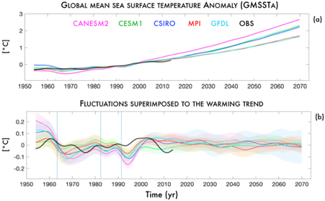
A joint role for forced and internally-driven variability in the decadal modulation
of global warming
Objective: Determine the relative importance of externally-forced and internally-driven variability in the decadal variability of global sea surface temperatures
Research:
--Examine global and tropical Pacific temperature variability in five large initial condition Earth System Models, with at least 30 members each, to better quantify the forced response
--Identify the dominant external forcing on decadal timescales to be volcanic aerosols, using single forcing runs of CESM1
Decadal variability in global mean sea surface temperature. (a) Global mean sea surface temperature (SST) anomaly (GMSST) time series computed from 8-yr low-passed SST. (b) Decadal-scale fluctuations in GMSST as highlighted by the GMSST residual obtained removing the quadratic fit from the time series shown in (a)
Impact: These results quantify the drivers of historical decadal variability and have profound implications for decadal climate predictions. The unpredictable nature of future volcanic eruptions suggests that a large portion of decadal-scale variability in global mean temperature might not be predictable
Liguori, G., McGregor, S., Arblaster, J.M., Singh M.S. and G.A. Meehl, 2020, A joint role for forced and internally-driven variability in the decadal modulation of global warming. Nat Commun 11, 3827, https://doi.org/10.1038/s41467-020-17683-7

